Slide 1

The Current and Future Landscape of Weatherization
Andrea Schroer
Weatherization Director NASCSP

Slide 2
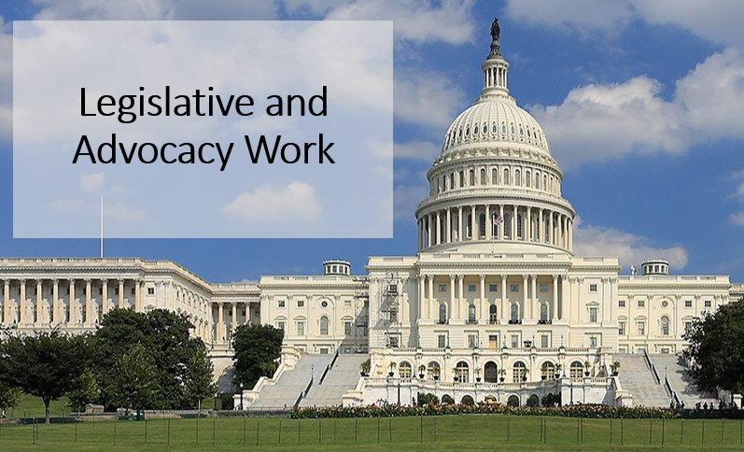
Statutory Policy:
Reauthorize the Weatherization Assistance Program and increase the administration percentage
Increase the Average Cost Per Unit (ACPU) to allow more funding to be provided per house and increase ACPU for renewable energy systems.
Institute a weatherization readiness fund within state appropriations that can be used to address deferrals outside of the ACPU calculation.
Increase Training and Technical Assistance funding to $10 million to support workforce development, evaluation and contractor training.

Slide 3
Infrastructure Funding:
Lesson Learned from ARRA
At least $3 billion on top of annual WAP appropriation
Longer period of performance is needed (5-10) years to expend funds and meet performance goals.
Limit Davis-Bacon wage restrictions to only multi-family buildings (5+ units).
Ensure appropriation post-stimulus aligns closely with authorization level of $350 million.

Slide 4
WAP Legislative Update
Reauthorized WAP for 5 years
Consolidated Appropriations Act 2021
Amended re-weatherization date to rolling 15 years
Signed into law December 2020
Authorized $350M for FY22-25
Increased Admin from 10% to 15%
Training funds can be used for private contractors
Established new Enhancement and Innovation Funds
Notes:
With the signing of the Consolidated Appropriations Act of 2021 into law in December 2020, the Weatherization Assistance Program has received congressional reauthorization as well as several significant policy changes – Many of which NASCSP and our national partners have been advocating for.
FIVE YEARS - Authorizes Congress to appropriate funds to the program for X amount of years. It was a static date – September 30 1994 – now it adjusts to a rolling 15 years. E&I =

Slide 5
WAP Legislative Update
$313M for Weatherization
Infrastructure Investment and Jobs Act
$3.5B for Weatherization
Funds available until expended
Davis Bacon waiver for single family and small multi-family
FY22 Appropriations
$6M for Training and Technical Assistance
15M for Weatherization Readiness
Signed into law 11/15/21
Signed into law 3/15/22
Sec. 40503 Energy Auditor Training Grant Program (BPI EA)
$40M total - grants to states not to exceed $2m

Slide 6
WAP Legislative Update
Build Back Better Act
$250M for grants for Lead-Based Paint & Housing-Related Health & Safety Hazard Mitigation
For households receiving weatherization assistance
WAP Improvements Act of 2022
Increases ACPU to $12K
Increases Renewables funds to $6K
Creates Wx Readiness Fund - $65M per year

Slide 7
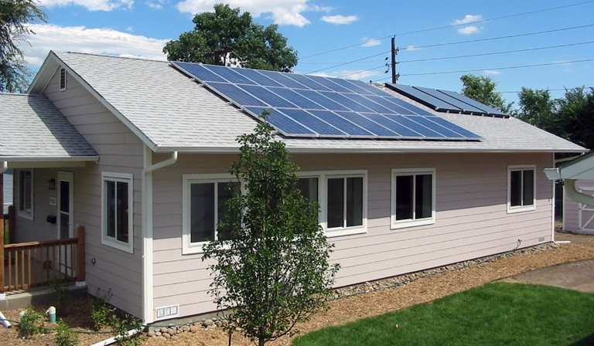
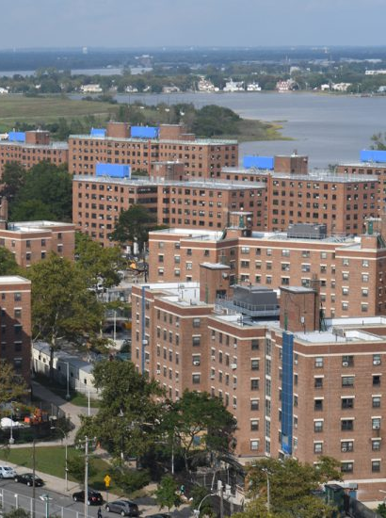
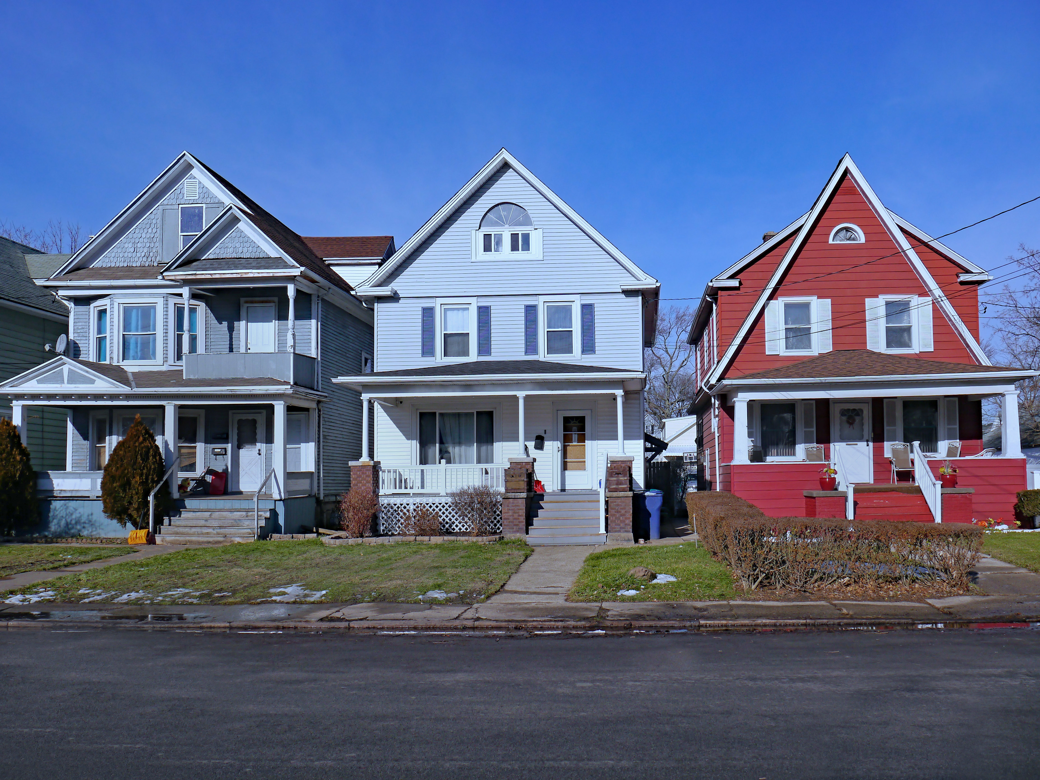
SERC and CSPP and E&I = Future Innovation
$12.3 M SERC
$1.5 M Community Scale
$18.6 M E&I
Notes:
DOE Slide rearranged

Slide 8
Competitive Grants
SERC – Memo 084 | E&I – Memo 086 | CSPP – Memo 085
Grantees, Subgrantees only | Grantees, Subgrantees, non-profits | Grantees, Subgrantees only
SIR: NO ACPU: NO | SIR: NO ACPU: NO | SIR: YES ACPU: YES
$12.3 Million (FY ‘20 and ‘21), administered through PY ‘22 grant. | $18.6 Million (FY ‘21 funding). Max grant $2M, Max annual allocation $25 M | $1.5 Million, administered through PY ’22 grant.
Response due 3/1/22 | Concept paper due 2/3/22 Full application due 3/28/22 | Response due 3/1/22
Purpose: Expand program for ‘materials, benefits, and renewable and domestic energy technologies not currently covered’ in WAP. *Memo 084 updated on 2/2/22 **SERC, CSPP Training | Purpose: Demonstrate opportunities for innovation and enhancement. Focus on 1. Place based initiatives, 2. MF housing, 3. Single family, manufactured housing, 4. Workforce development. Q&A | Purpose: Weatherize complex projects grouped by geographic location, housing type, demographics. *Memo 085 updated on 2/2/22 **SERC, CSPP Training
Notes:
JONATHAN – NASCSP collected and delivered the networks Questions to DOE earlier this month on the above.
Memos 84 and 85 were updated with a new application submission platform, due dates remain 3/1/22
SERC Project Examples: heat pumps (geothermal, air source), PV, solar DHW, combination/indirect water heating, small scale wind, cool roofs. Annual funds based on Annual Allocation. Funding level – up to 2% of Annual allocation when it exceeds $275M. These funds are at the discretion of the Sec. of Energy
E&I Funding: based on annual appropriation. 225 – 259 Million = 2%. 260 – 299 Million = 4%. 300 Million and up = 6%. As a reminder house and senate appropriations committees proposed funding WAP at $375 Million

Slide 9
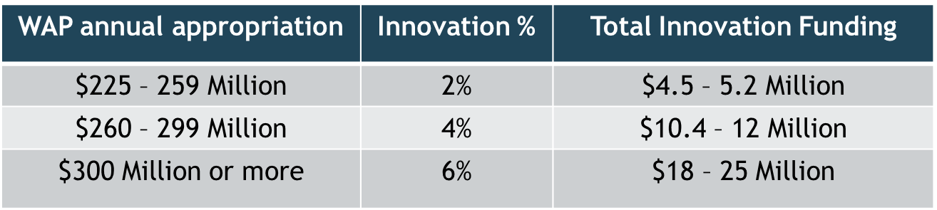
DOE – Enhancement & Innovation
Priority Ranking from March Listening Sessions:
Weatherization-Readiness
Healthy Indoor Environments
Workforce Development, targeting under-served communities
Renewable Energy Technologies
Disseminate New Methods and Best Practices
Notes:
https://www.energy.gov/eere/apply-eere-funding-opportunities (slide 13 link)

Slide 10
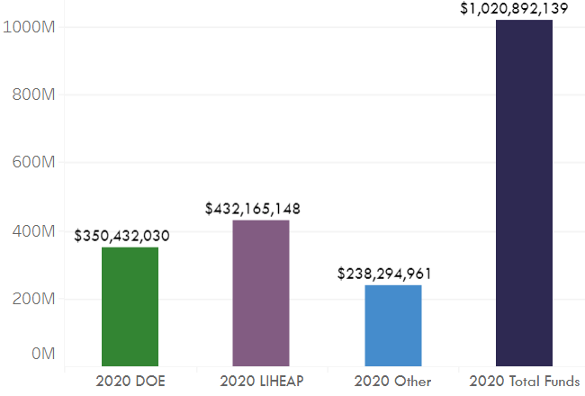
LIHEAP Delivers Flexibility in WAP
According to 2021 LIHEAP Plans, common exceptions include:
Grantee’s using MOSTLY DOE Rules – (37)
Average cost per unit (24 Grantees)
SIR relief (20 Grantees)
Re-weatherization date (13 Grantees)
Notes:
https://www.energy.gov/eere/apply-eere-funding-opportunities (slide 13 link)

Slide 11
2018 Agency Rules – 9 Grantees Entirely DOE rules
W
A
NH
VT
MT
ND
MN
OR
MA
ID
SD
WI
NY
W
Y
MI
CT
RI
NE
IA
P
A
NV
UT
IL
OH
NJ
CA
CO
IN
WV
DE
V
MD
KS
A
DC
MO
K
Y
AZ
TN
NC
OK
NM
AR
SC
MS
AL
GA
AK
TX
LA
Not applicable
Entirely DOE Rules
FL
Mostly DOE Rules
Hawaii
Northern
Mariana
Islands
Mostly LIHEAP Rules
Virgin IsIands
Puerto Rico
Entirely LIHEAP Rules
Guam
American Samoa
Notes:
13 Entirely DOE and LIHEAP Rules

Slide 12
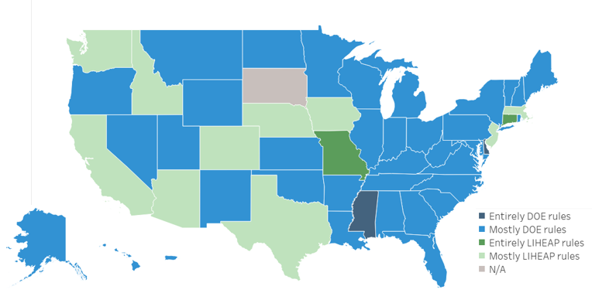
2021 Agency Rules – Only 2 Grantees use Entirely DOE rules.
Notes:
Versus what we have currently in the 2021 LIHEAP state plans – only 2 Grantees use Entirely DOE/LIHEAP. Again, the VAST majority of states are now selecting MOSTLY DOE or MOSTLY LIHEAP rules to bring flexibility into the WAP w LIHEAP WAP funds.

Slide 13
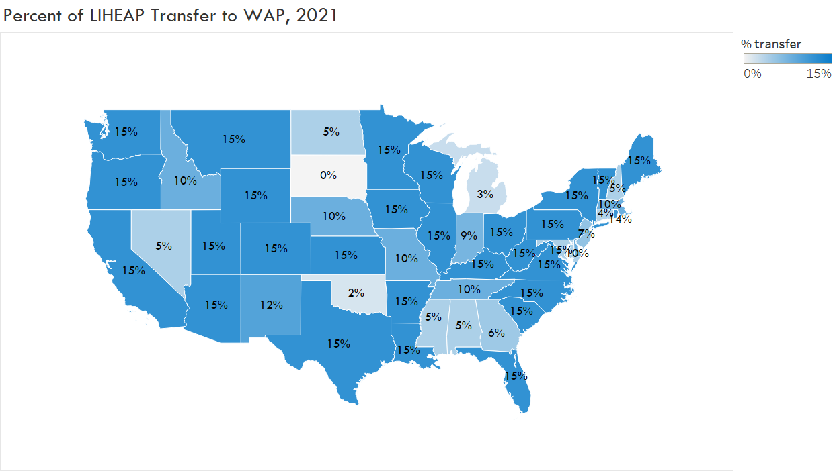
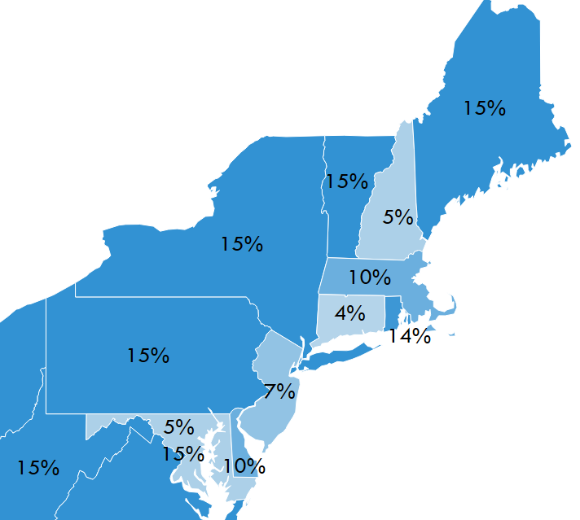
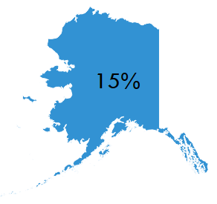
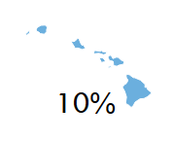

Notes:
78% of the Grantee get 10-15% of the transfer with most getting the full 15%.
Only 5 Grantees out of 57 get less than 5% transfer or less, the vast majority get 15% and this is incredibly helpful because the LIHEAP funding can deliver flexibility into the WAP. Maximizing the LIHEAP transfer and the flexibilities inherent in a BLOCK GRANT program will bode very well for the future of WAP!

Slide 14

Thank you!
Andrea Schroer
Weatherization Director
NASCSP
Notes:
https://www.energy.gov/eere/apply-eere-funding-opportunities (slide 13 link)

