Slide 1

Energy Hardship Report February 2026

Slide 2
Introduction
Electricity costs have risen sharply for American households since 2021, far outpacing inflation and accelerating again this year. According to the U.S. Energy Information Administration, the average monthly residential electricity bill increased from about $121 in 2021 to roughly $156 in 2025, a rise of nearly 29 percent.
This report outlines the urgent policy actions needed to protect vulnerable households from rising energy prices and ensure equitable access to essential utility services.
NEADA is the primary educational and policy organization for state directors of the Low Income Home Energy Assistance Program (LIHEAP). LIHEAP is a federal program that provides formula grants to states to help low-income families pay their home energy bills.

Slide 3
Affordability Programs Must Be Part of the Solution
As utility rates continue to rise, utility companies must take responsibility for ensuring affordability. Low- and moderate-income households should not be expected to shoulder any portion of the high costs associated with grid modernization or data center expansion.
Utilities should implement strong affordability safeguards, including:
Capping household electricity costs as a percentage of income, consistent with what the average U.S. household pays for home energy;
Providing discounted rates for income-qualified customers;
Offering bill forgiveness and arrearage relief programs for families who fall behind on payments; and
Ensuring comprehensive shut-off protections for customers who are unable to pay their utility bills.
Without these protections, families already struggling to make ends meet will face deepening financial hardship and an increased risk of losing access to essential energy services.

Slide 4
Energy Price Increases Fall Hardest on Low-Income Households
The average energy burden for low-income households is about 9.1 percent of income, almost 3.8 times the rate for other households (2.4 percent). Of even more concern are findings from the most recent Census Household Pulse Survey, designed to estimate the economic impact of the pandemic on families, which found the percentage of low- and moderate-income households that could not pay their energy bill for at least one month between August 2023 and August 2024 increased from 35.5 percent to 37.4 percent (see page 5).

Slide 5
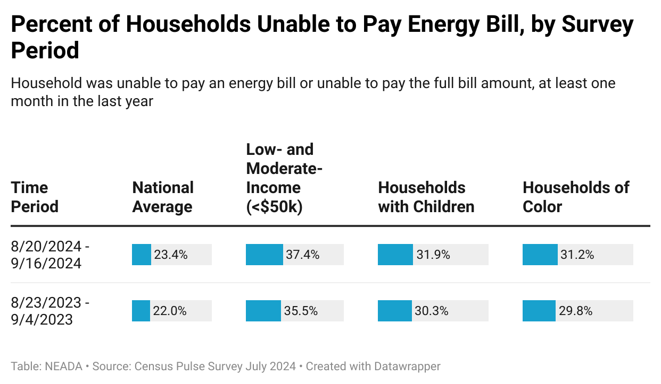
Families Struggle to Pay their Home Energy Bills
The Census Bureau’s Pulse Survey reported 23.4% of households could not pay their energy bill for at least one month in the 2024, an increase from 22.0% in 2023.
Of even greater concern, for low-income households, those earning less than $50k, during this same period, the percent of households that could not pay their utility increased from 35.5% to 37.4%.

Slide 6
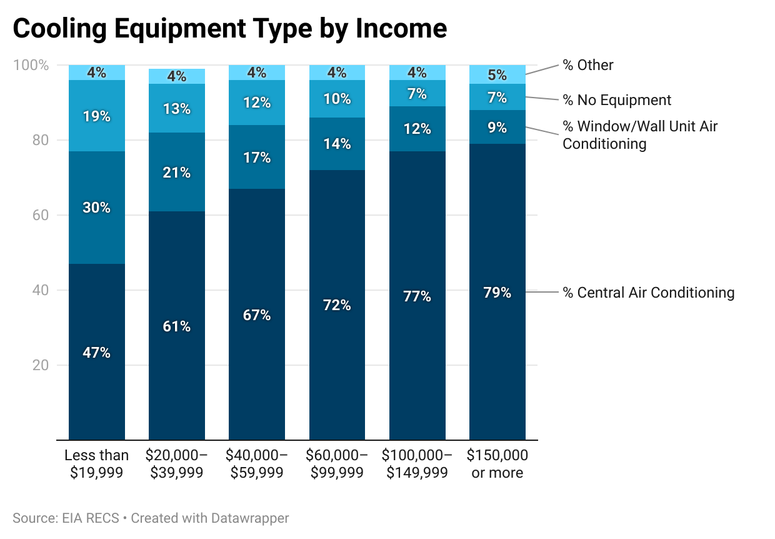
Low-Income Families Are Less to Have Access
to Cooling in the Home than Other Families
While almost all families have access to home heating access to home cooling is limited by income. Nearly 20% of low-income households do not have cooling in their homes, and 30 percent rely solely on window units.

Slide 7
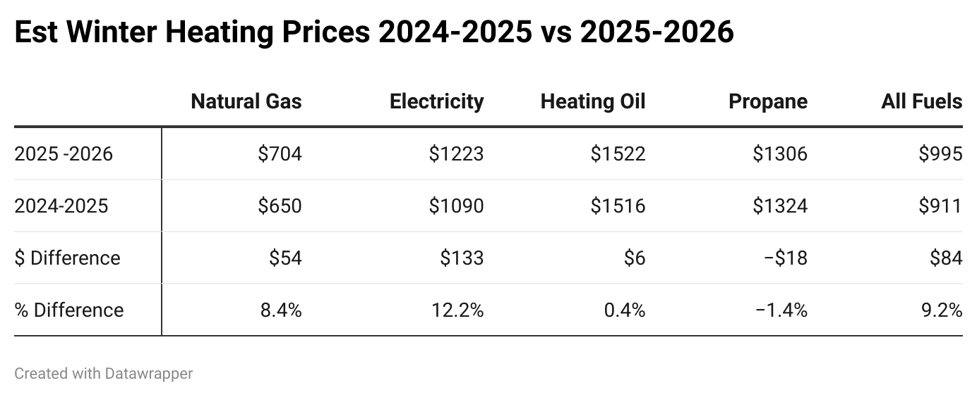
U.S. home heating costs are projected to rise 9.2 percent this winter, more than three times the rate of inflation, driven by higher electricity and natural gas prices and colder-than-average weather.
On average, households are expected to spend $995 on heating this winter, an increase of $84 from last year.
Families that rely on electric heating are projected to see the largest increases, with costs rising 12.2 percent.
Families using natural gas are expected to see heating costs increase 8.4 percent.
Heating oil and propane users are expected to see costs remain roughly flat, as lower fuel prices offset higher consumption caused by colder weather.

Slide 8
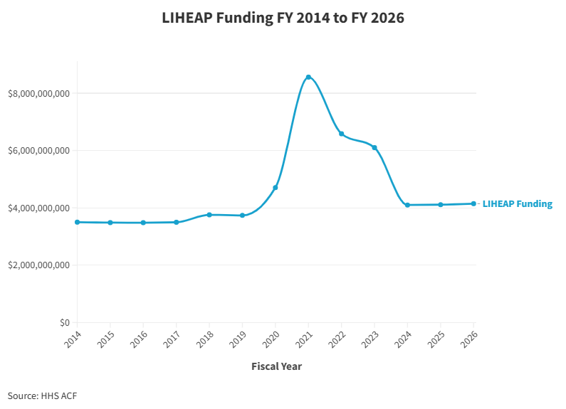
Federal Support is Limited
The Low Income Home Energy Assistance Program (LIHEAP), the primary federal program to help families pay their energy bills is a vital lifeline providing about $4 billion annually. Federal funding increased during the pandemic as families lost their jobs and were unable to pay their utility bills and then returned to about $4 billion in 2024 and is expected to remain at that level through FY 2026.
Funding is only sufficient to help about 17 percent of the eligible population. Leaving many at risk of falling behind on their utility bills and being shut-off from power.
States are urging Congress to restore LIHEAP to $6 billion and add $1 billion in contingency funds to respond to fuel price spikes and climate emergencies.

Slide 9
LIHEAP Support to Help Low Income Families is not Adequate to Cover Both Heating and Cooling Needs
Extreme heat poses serious dangers for low-income families, placing them at heightened risk during the summer months when heat waves and prolonged periods of extreme temperatures are more common.
However, LIHEAP funds are primarily used to cover winter heating costs. On average, about 80 percent of LIHEAP funding is spent on heating assistance, leaving limited resources available for summer cooling needs.
Low-income households are especially vulnerable to extreme heat due to limited access to affordable cooling and rising electricity costs. As a result, cooling assistance remains uneven and insufficient—during the summer of 2025, only 26 states and the District of Columbia offered LIHEAP-funded cooling assistance.

Slide 10
Funding for LIHEAP Must be Increased to Cover Summer Cooling Costs
The only way for LIHEAP to provide year-round assistance without cutting critical winter support for families is through increased funding. To keep pace with rising energy costs, higher temperatures, and more frequent extreme weather events, states have asked Congress to increase LIHEAP funding to $6 billion, with an additional $1 billion for the program’s contingency fund, for a total of $7 billion.
Contingency funding would allow the Administration to deliver targeted LIHEAP assistance during extreme cold or heat emergencies.

Slide 11
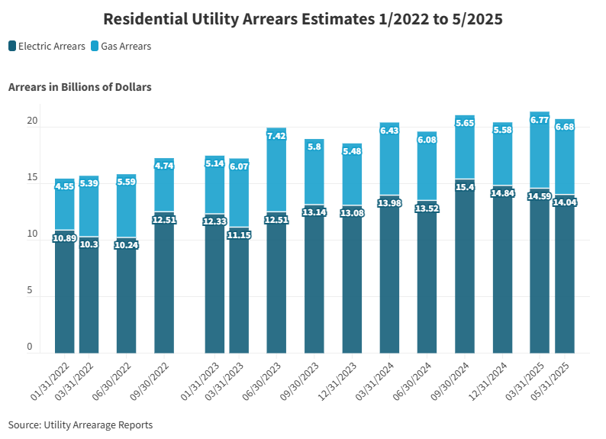
Utility Debt and Shut-Offs Have Reached Crisis Levels
About 21.5 million U.S. households—roughly 1 in 6—are behind on their energy bills. These numbers are expected to worsen as families face the double impact of costly winter heating and summer cooling. Household utility debt is reaching crisis levels.
Outstanding utility debt jumped from $15.4 billion in January 2022 to $21.4 billion at the end of March 2025. Utility shut-offs are also increasing from about 3.3 million in 2023 to about 3.5 million in 2024 and could reach as high as 4.0 million by the end of 2025.
Sources: Select publicly-available state and utility arrearage data

Slide 12
Billions in Rate Hike Requests
An increasing number of utilities have already submitted multibillion-dollar rate increase proposals to cover infrastructure improvements and expanding demand. These costs will ultimately be passed on to ratepayers regardless of their ability to pay. Recent examples include: Florida Power & Light $10 billion, Southern California Edison $3.27 billion, PG&E $3.1 billion, Con Ed $2 billion, CenterPoint Energy $1.3 billion and DTE Energy $574 million.
The current trajectory of rate increases signals that electricity prices will likely continue outpacing inflation, raising alarms about equity and access. If low-income families are left to shoulder the financial burden, utility arrears and shut-offs will inevitably rise.

Slide 13
Electric & Natural Gas Expenditure for All Income Quintiles
Lowest 20%
Year | Electric & Natural Gas | Income | % Income Energy | Difference
2025 | $1,705 | $17,291 | 9.86% | 9.1%
2024 | $1,563 | $16,658 | 9.38%
Second 20%
Year | Electric & Natural Gas | Income | % Income Energy | Difference
2025 | $2,276 | $44,556 | 5.11% | 9.2%
2024 | $2,084 | $42,925 | 4.85%
Third 20%
Year | Electric & Natural Gas | Income | % Income Energy | Difference
2025 | $2,482 | $77,304 | 3.21% | 9.3%
2024 | $2,271 | $74,474 | 3.05%
Fourth 20%
Year | Electric & Natural Gas | Income | % Income Energy | Difference
2025 | $2,820 | $126,167 | 2.24% | 9.4%
2024 | $2,578 | $121,548 | 2.12%
Top 20%
Year | Electric & Natural Gas | Income | % Income Energy | Difference
2025 | $3,429 | $274,561 | 1.25% | 9.7%
2024 | $3,127 | $264,510 | 1.18%
All Consumers
Year | Electric & Natural Gas | Income | % Income Energy | Difference
2025 | $2,544 | $108,167 | 2.35% | 9.4%
2024 | $2,326 | $104,207 | 2.23%
Energy consumption does not increase proportionally with income. Families with low incomes spend a higher percentage of their income on energy.
For the lowest income families, average expenditures increased from 9.38% of income in 2025 to 9.86% in 2025 while for all consumers, the average expenditures average about 2.23% of income to 2.35%.
Source: BLS Consumer Expenditure Survey

Slide 14
Contact:
Mark Wolfe Cassandra Lovejoy
Executive Director Policy Director
mwolfe@neada.org clovejoy@neada.org
Shayon Moradi
Senior Research Associate
smoradi@neada.org

