Slide 1

Federal Actions Squeezing Families & State Options for Mitigating Harm
Sharon Parrott, President
Center Budget and Policy Priorities - cbpp.org

Slide 2
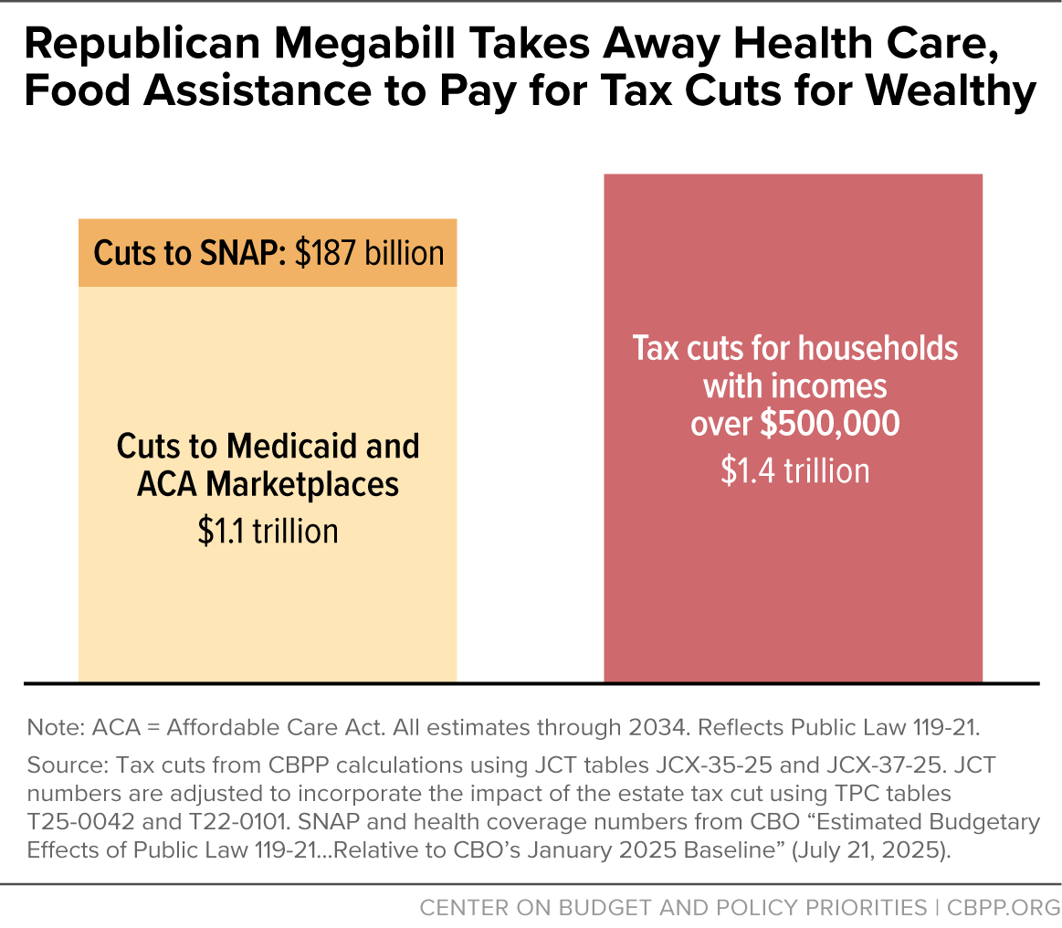

Slide 3
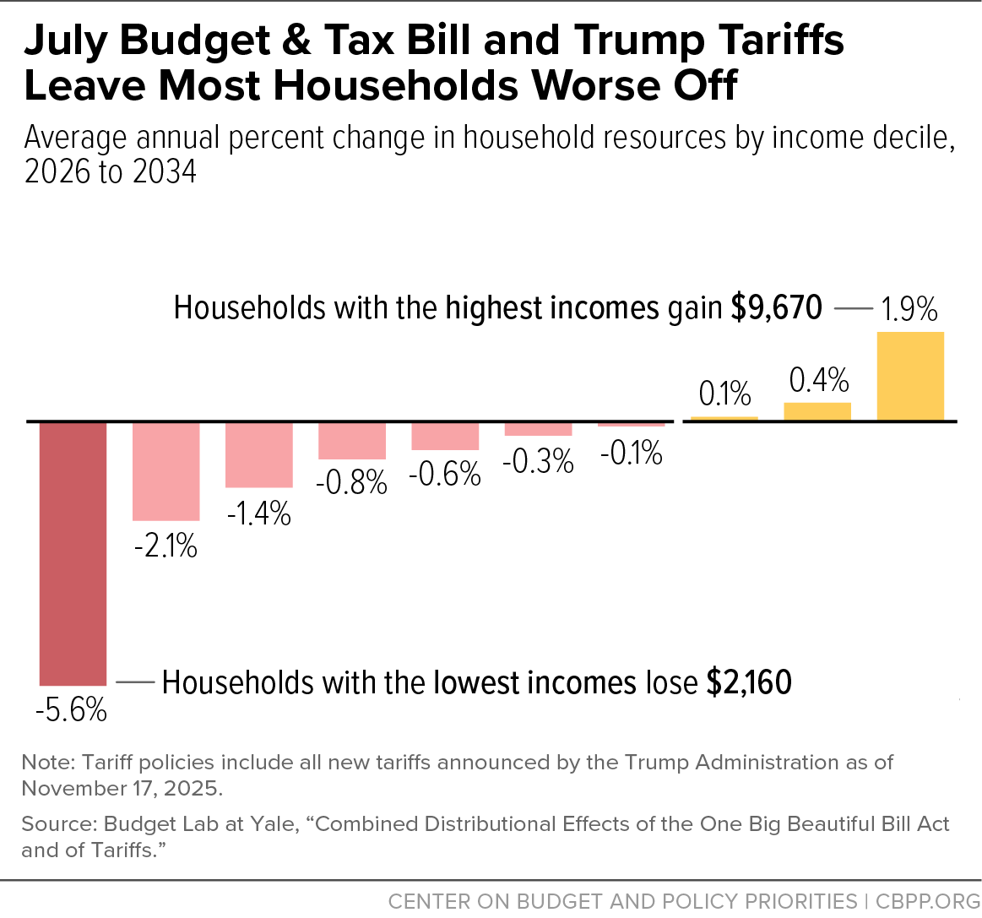

Slide 4
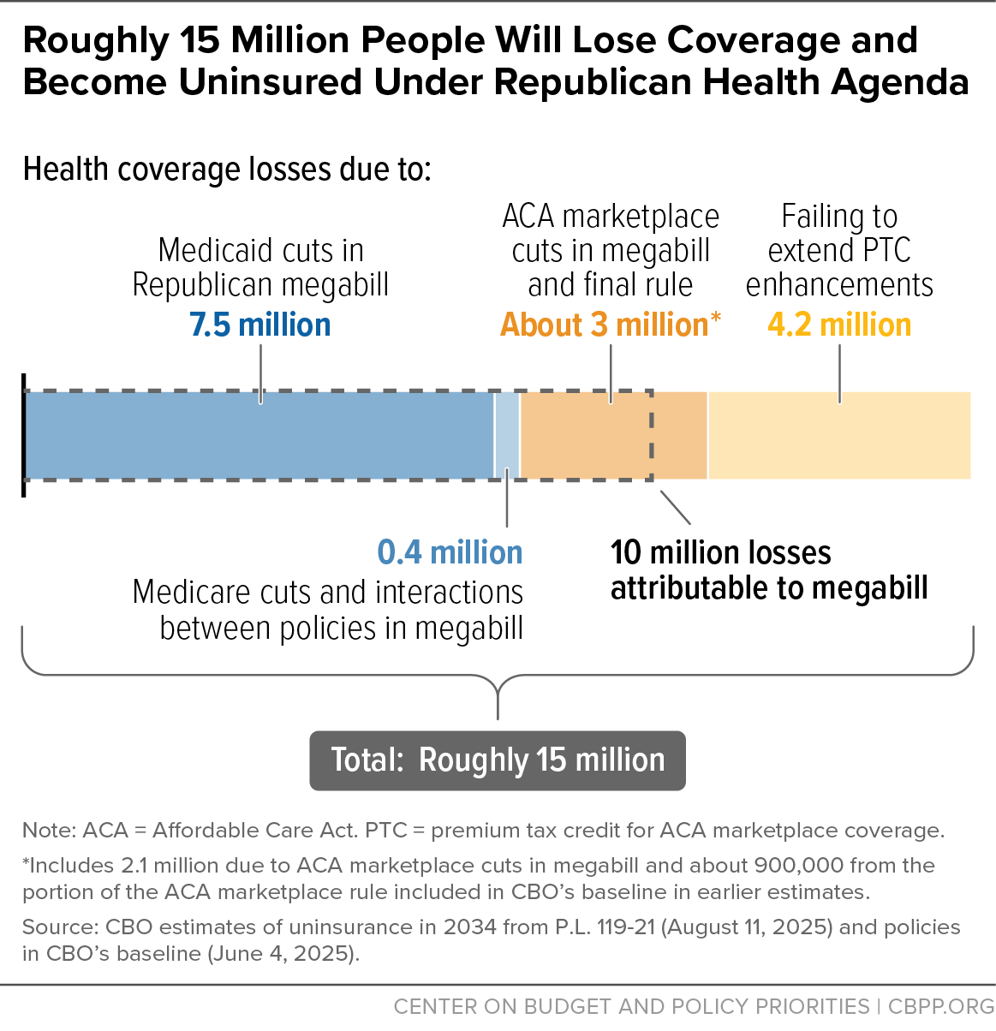

Slide 5
