Slide 1
PMIWG Update
NEADA Winter Meeting
March 12, 2026

Slide 2
Agenda
During this session, we will:
Provide a brief overview of PMIWG teams
Provide an update from each PMIWG team on current projects
Demonstrate the IT Solutions Survey Database
Answer any questions from NEADA members

Slide 3



Three PMIWG Teams
Performance Management Integration (PMI)
Creates tools and resources that help LIHEAP grant recipients incorporate Performance Management into their day-to-day work.
Data Case Studies
Facilitates discussion and highlights interesting uses of data so that grant recipients can better understand and use their Performance Management data.
Data Reliability
Empowers grant recipients to improve their data quality and then use those data to make informed decisions.

Slide 4
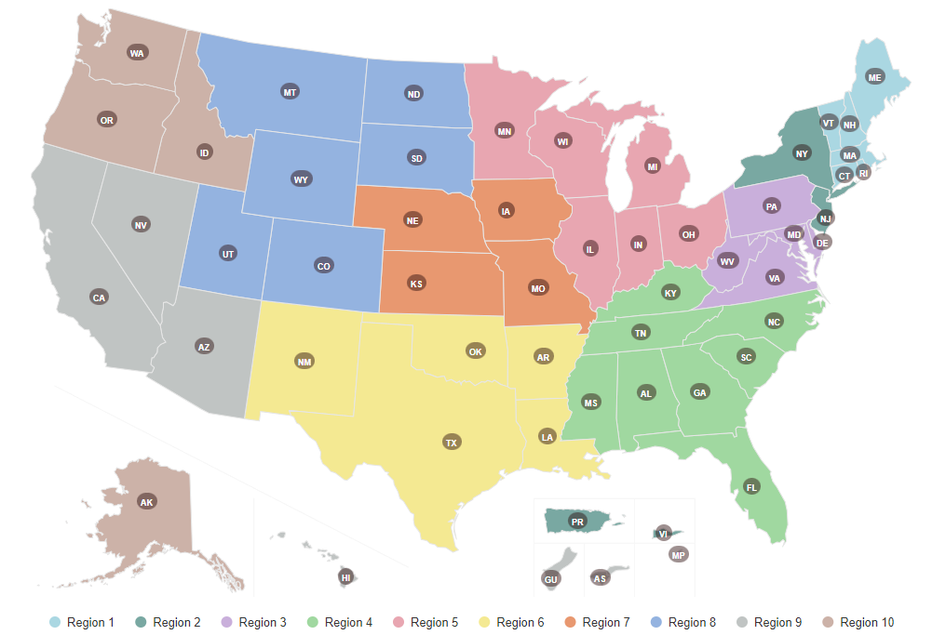
PMIWG Membership
PMIWG Members
States, Tribes, and Territories
  Region 1 – VT, NH
  Region 2 – NY, PR
  Region 3 – PA
  Region 4 – GA, MS
  Region 5 - WI, MN
  Region 6 – AR
  Region 7 – IA
  Region 8 – CO, ND, Rosebud Sioux
  Region 9 – CA, American Samoa
  Region 10 – WA, OR

Slide 5
Upcoming Work Group Presentations/Training
Upcoming Work Group Presentations/Training
The PMIWG is hosting several sessions at NEUAC, featuring experts from across the network:
Pre-Conference Session—LIHEAP Basics
Pre-Conference Session—LIHEAP Program Management for Tribes
LIHEAP 101 (Program Integrity and LIHEAP Flexibilities)
LIHEAP 102 (Streamlined Enrollment Processes)
State-Tribe Agreements

Slide 6
Performance Management Integration Team
Presenter: Maria Hopps (CO)
Project Team Members:
Sisavai’i Tuala-Tamaalelagi (AS) Bobbi Davis (WI)
Johana Hernandez (PR) Michelle Gillham (AR)
Cynthia Bryant (GA) Lisa Goben-Toninato (OR)

Slide 7


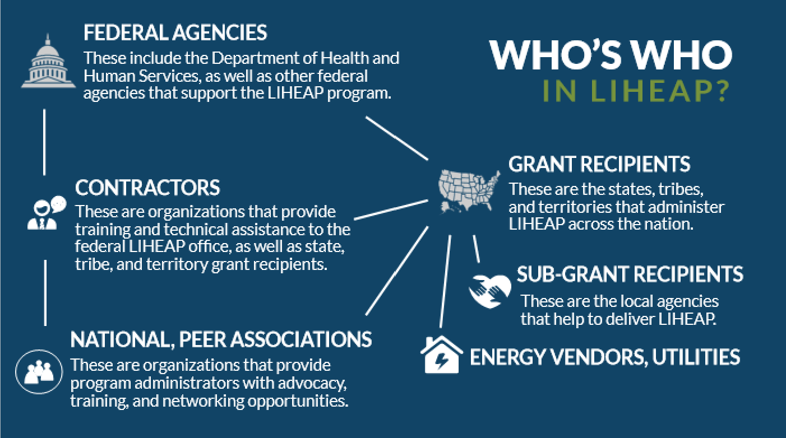
PMIWG Project Team Updates
Performance Management Integration (PMI) Team
Current Projects — Online LIHEAP Training Tool
Self-paced training resource for LIHEAP administrators. Features interactive learning tools, activities, and assessments (e.g., quizzes).
Highlighted Project Accomplishments
Four courses finalized and posted in library.
Getting Started in LIHEAP (Micro-Lesson)
Who’s Who in LIHEAP?
Finding LIHEAP Resources
LIHEAP and the Law
Started testing with interested NEADA members.

Slide 8

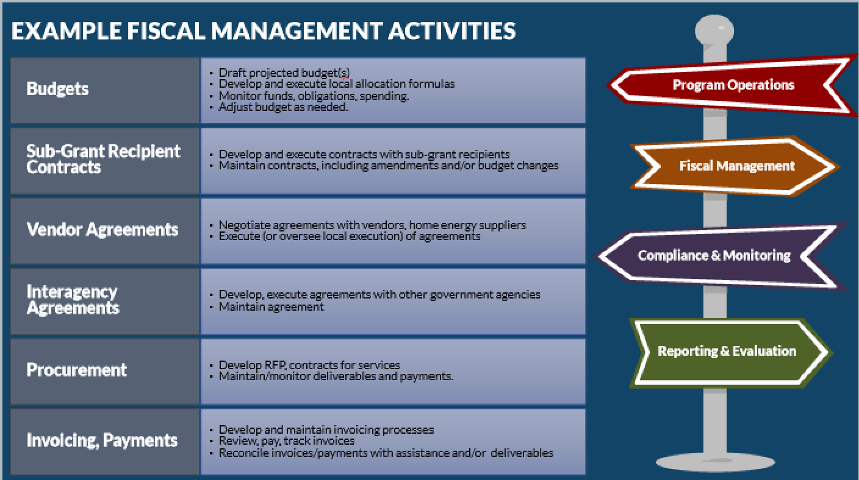
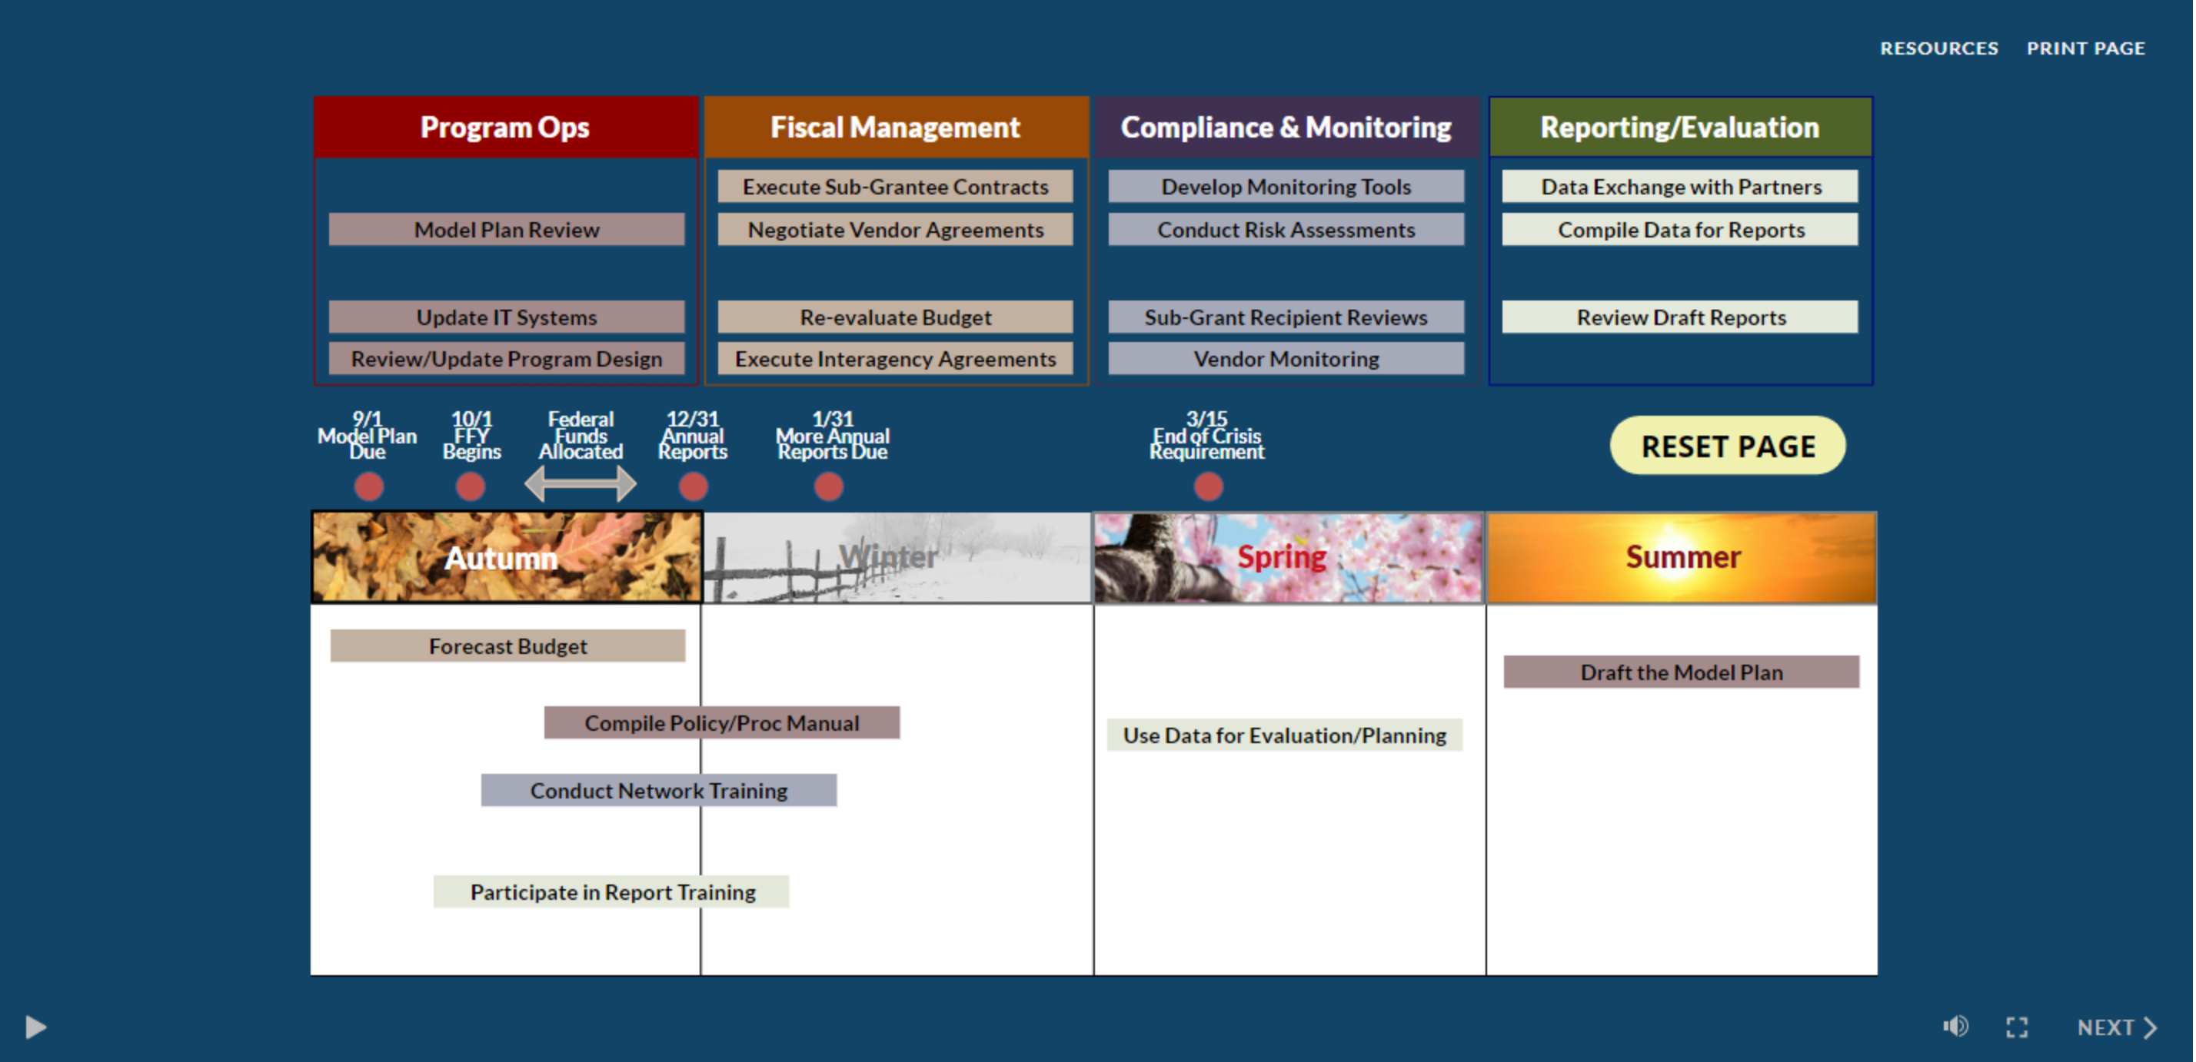
PMIWG Project Team Updates
Performance Management Integration (PMI) Team
Project Timelines
Finalizing “Program Administration Basics” course (to be posted within next couple of weeks).
Includes a breakdown of common LIHEAP administrative responsibilities, tasks, and activities.
Interactive reviews of common tasks by categories, and annual timing.
Started work on “Data Collection and Reporting” course to be completed in April/early-May.
Are you interested in trying out the LIHEAP online training tool?
Contact a PMIWG member or click here to register.

Slide 9
Data Case Study Team
Presenter: Brian Whorl (PA)
Project Team Members:
Malelega Tuiolosega (AS) Ian Villa-Watt (MN)
Monica Popescu (CA) Brian Whorl (PA)
Maria Hopps (CO) Brian Sarensen (WA)
Christine Taylor (IA)

Slide 10

PMIWG Project Team Updates
Data Case Study Team
Current Projects
  Data Analyst Brownbags
      Goal = Gather for informal quarterly presentations and open discussion on important LIHEAP data topics
  Case study on Impact of Ratepayer Assistance on Performance Measures
      Goal = Assess how the LIHEAP Performance Measures results are impacted by the inclusion of ratepayer assistance for three states.
  Case study on using data to understand the impact of Wage Verification process
      Goal = Use data from one state that implemented a new wage verification process to assess the impact on income and wage requests and applications.

Slide 11
PMIWG Project Team Updates
Data Case Study Team
Highlighted Project Accomplishments:
Quarterly Data Analyst Brownbags
Brownbag on Using Data on Inform Outreach Strategies
  MN, WI, CO, and RI presented on different ways they have used data to help with outreach approaches and measuring the impact of outreach methods.
  Approximately 50 attended.
Brownbag on LIHEAP Data Systems Demonstrations
  MN and CO showcased examples of their data systems and how they complete tasks like:
      Adding/reviewing application information
      Determining application statuses
      Fulfilling federal reporting requirements
      Completing ad hoc data requests
    Approximately 60 attended.

Slide 12

PMIWG Project Team Updates
Data Case Study Team
Project Timelines
Next Brownbag:
June – Using Data to Assess and Assist Subrecipients
  Summer:
  Complete Case Study on Impact of Ratepayer Assistance on Performance Measures
  Complete Case Study on Use of Wage Verification System data

Slide 13
Data Reliability Team
Presenter: Josh Haugen (ND)
Project Team Members:
Deeannah Loia (AS) Lori Walking Eagle (RST)
Leah Richards (NH) Richard Giddings (VT)
Verkista White (MS) Josh Haugen (ND)
Keri Stark (NY)

Slide 14
PMIWG Project Team Updates
Data Reliability Team
Current Projects
IT Solutions Survey
  Purpose: Document whether each grant recipient has an IT Solution for a given program requirement (e.g., outreach, intake).
  Goals:
    Peer-to-Peer Network: Publish results to facilitate peer-to-peer exchange.
    OCS T&TA Planning: Document needs for planning efforts.
  Two Versions:
    States – Survey conducted with 48 grant recipients in 2025; database with survey results in progress.
    Tribes & territories – Currently being developed.

Slide 15
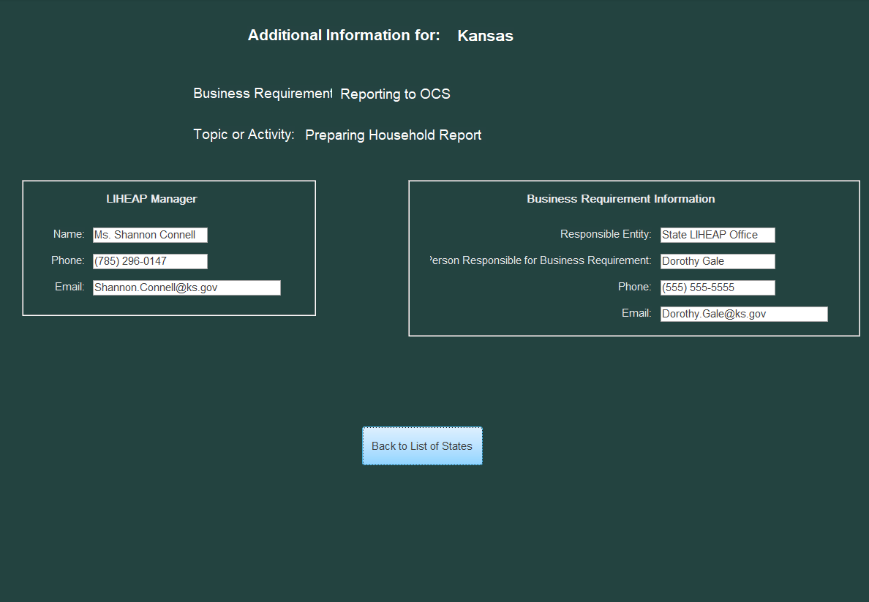
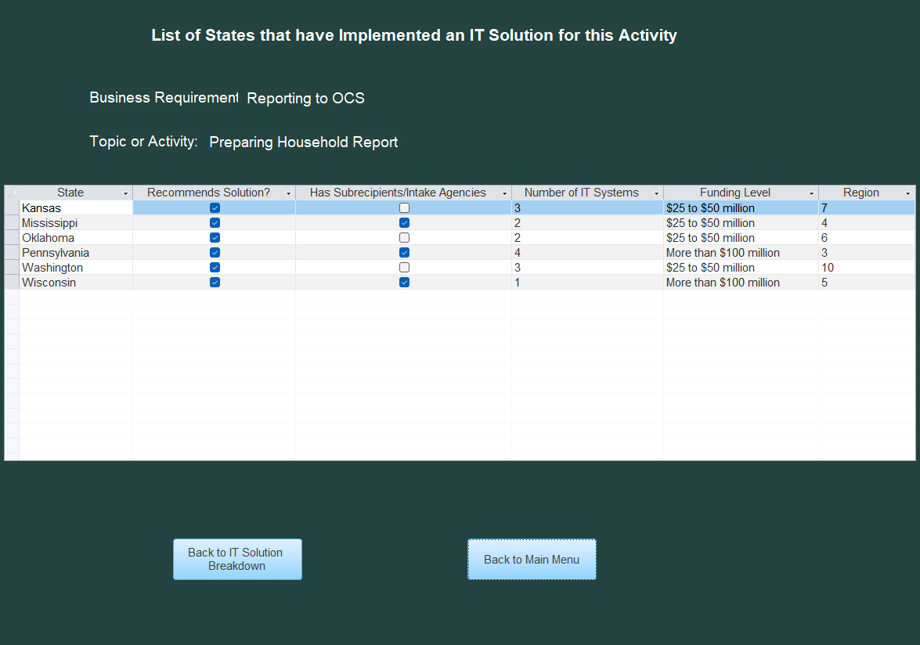
PMIWG Project Team Updates
Data Reliability Team
Highlighted Project Accomplishments:
IT Solutions Survey for States: Microsoft Access Database Prototype
Allows grant recipients to explore survey results in a structured format, including:
  The most-used IT solutions.
  List of states with a given solution.
  State-specific details for additional context.
  Contact information for program managers and personnel responsible for business requirement.
Publishing the database:
  Prototype complete; currently undergoing testing by the PMIWG.
  Will be posted to the LIHEAP Performance Management Website (PMW).

Slide 16

PMIWG Project Team Updates
Data Reliability Team
Project Timelines
IT Solutions Survey Access Database
  March & April – PMIWG testing
  May – Publish database for all grant recipients
  IT Solutions Survey for Tribes and Territories
  April – Engage with tribes and territories to discuss approach to survey
  Next Steps – Design and test the survey

Slide 17
PMIWG Project Team Updates
Data Reliability Team
Demonstration of IT Solutions Survey
Access Database

Slide 18

Questions and Discussions

Slide 19
Thank you!

