Slide 1



2026 Director Training
Washington DC
March 10-11, 2026
Melissa Torgerson, VERVE

Slide 2
Introduction, Session Objectives
After this training, participants will better understand:
Grant recipient flexibility when interpreting federal statute/law.
The basics of federal LIHEAP assurances.
How different states and territories design their programs.
Where to find and how to use additional resources.

Slide 3
Training Outline
Getting Situated as a New LIHEAP Director
How the LIHEAP Law impacts program design
Assurance 1: Uses of Funds
Including 2604(c)—Crisis Funds
Grant Recipient Panel
Assurance 2: Eligibility
Grant Recipient Panel
Assurance 3: Outreach

Slide 4
Training Outline (continued)
Assurance 5: Benefits
Grant Recipient Panel
Assurance 8: Equitable Treatment
Discussion
Assurance Round-Up
Remaining Assurances
Questions/Resources

Slide 5
2026 Overarching Themes, Hot Topics
Contingency Planning (building flexibility into your programs)
Program Integrity (accountability, controls, and transparency on all levels)
What other themes or concepts should be included?

Slide 6

Getting Situated in LIHEAP

Slide 7
Identify and reach out to your HHS Liaison
Email NEADA and use their listserv
Become oriented to key LIHEAP websites
Take advantage of online training materials
Find mentors in and out of your state/territory
Scour your state/local documentation

Slide 8
Federal Law
Federal statute and regulations set the outer boundaries for program design.
Compliance Reviews, Audits
(Past Findings, Corrective Actions)
State/Territory Law
State/Territory statute, code, and rules may be “stricter” than federal rules.
Model Plan
The Model Plan tells HHS how your state/territory LIHEAP program is designed.
Subgrantee, Vendor Monitoring
(Tools, Past Findings, Corrective Actions)
Policy and Procedures Manuals
Policies and procedure manual(s) spell out how the program aligns with Model Plan.
Subgrantee and Vendor Agreements
Agreements spell out how contractors deliver LIHEAP in alignment with Model Plan.
Reports
(Federal, State, Internal)
Reports tell how your state/territory used LIHEAP funds in accordance with Model Plan.

Slide 9

LIHEAP as a Block Grant

Slide 10
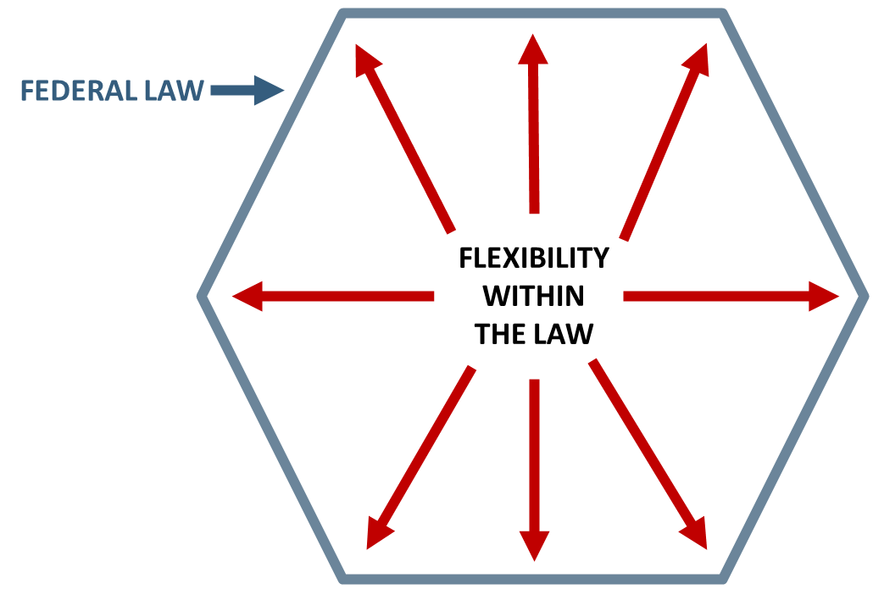
LIHEAP is a Block Grant
While LIHEAP grant recipients must follow federal statute, the law gives them considerable flexibility in designing in designing and operating their programs.
LIHEAP Statute Section 2605(b):
“The Secretary [of Health and Human Services] may not prescribe the manner in which the state will comply with the provisions of this subsection.”
Block Grant Regulations at (45 CFR 96.50(e)):
Grant recipients are largely responsible for interpreting statute
Individual grant recipients may reach different interpretations of statute
HHS will defer to grantee interpretation unless “clearly erroneous.”

Slide 11
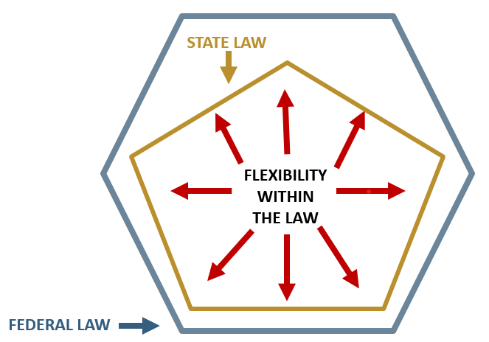
11
State, Tribe, Territory Law
While the federal statute provides “outer bounds” for grantees, state/tribal law can also influence or restrict the design and delivery of LIHEAP programs.
For example, although the federal statute allows income eligibility up to 60% of state median income, some states have enacted laws that make their LIHEAP income eligibility thresholds much lower.

Slide 12









Block Grant Responsibility, Boundaries
The flexibility associated with LIHEAP means that recipients can (and should) design programs that best fit the needs and resources in their communities.
Climate
Geography
Eligible Population/
Household Needs
Fuel Types
Available Resources
To take full advantage of Block Grant flexibility, grant recipients and their partners must have a basic understanding of LIHEAP law.

Slide 13
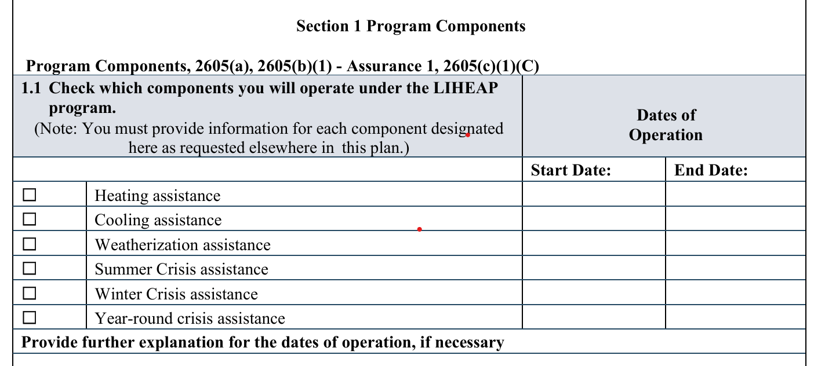
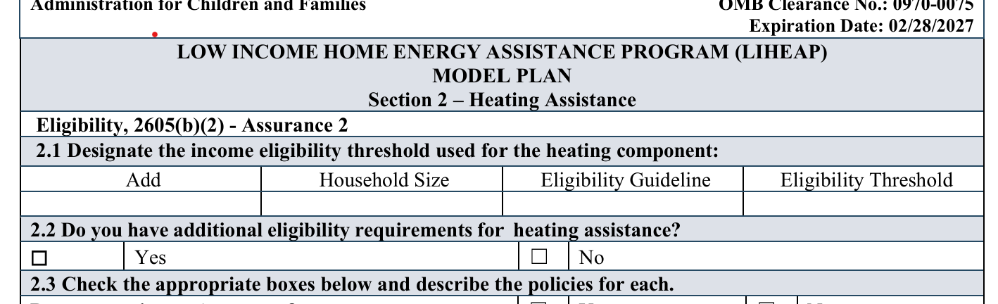
The LIHEAP Assurances

Slide 14
The LIHEAP Assurances
Every September, states, tribes, and territories who wish to receive LIHEAP funding must submit a model plan. The model plan (LIHEAP application) lays out how each grantee will use LIHEAP funds in accordance with the law.
“Each State desiring to receive an allotment for any fiscal year under this title shall submit an application to the Secretary. Each such application shall contain assurances by the chief executive officer of the State that the
State will meet the conditions enumerated in section (b).”
“Each State desiring to receive an allotment for any fiscal year under this title shall submit an application to the Secretary. Each such application
shall contain assurances by the chief executive officer of the State that the State will meet the conditions enumerated in section (b).”
Section 2605(a)(1) of the LIHEAP Act, 42 U.S.C. § 8624(a)(1)
These sixteen conditions, or “assurances” form the foundation for all LIHEAP programs, and will be our primary focus during this training.

Slide 15

Breaking it Down
(Key Takeaways)
What are the key takeaways?
Interpretation & Implementation
What are the details we must consider?
Bringing it
Back Home
How will we interpret and implement each Assurance?
Resources
How can we learn more?

Slide 16
Please note we will be navigating through the Assurances in the following order to make the best use of limited time:
Assurance 1,
Assurance 2,
Assurance 3,
Assurance 5,
Assurance 8
Assurance Round-Up (all of the remaining)

Slide 17
Breaking it Down
(Key Takeaways)
Assurance 1: USES OF FUNDS
Section 2605(b)(1) of LIHEAP Act, 42 U.S.C. § 8624(b)(1)
The funds grantees receive for LIHEAP must be used only for purposes explicitly authorized in the law. These include:
heating and/or cooling assistance
crisis assistance
weatherization and energy-related home repair
outreach to households with lowest income and highest home energy needs
planning, development, and administration (including leveraging)

Slide 18
Interpretation & Implementation
Assurance 1: USES OF FUNDS
What are the details grant recipients must consider?
Which program components will we administer? | How will we allocate funding? (% to each component
WHEN will we use our funds? (Winter versus year-round) | What will each program component include?
LIHEAP CRISIS Section 2605(b)(1) of LIHEAP Act, 42 U.S.C. § 8624(b)(1)
A reasonable amount of award (based on data from prior years) shall be reserved until March 15 of each program year for energy crisis intervention.
The program for which funds are reserved under this subsection shall
Not later than 48 hours after a household applies for energy crisis benefits, provide some form of assistance that will resolve the energy crisis if such household is eligible to receive such benefits;
Not later than 18 hours after a household applies for crisis benefits, provide some form of assistance that will resolve the energy crisis if such household is eligible to receive such benefits and is in a life-threatening situation;
Notes:
Data from 2018 plans

Slide 19
Bringing it
Back Home
Assurance 1: USES OF FUNDS
How will we interpret and implement Assurance 1?
Demand | Are we turning away households from one component (e.g., heating) in order to keep another (e.g. cooling)?
Need | Are we seeing an increase in households with high energy usage or inoperable equipment that may warrant more crisis or weatherization services?
Climate | Are more households requesting LIHEAP during months when the program hasn’t typically been offered (e.g., summer)?
Resources | Do we have money left over at the end of each heating season that could fund cooling, summer crisis, or year-round crisis programs?

Slide 20

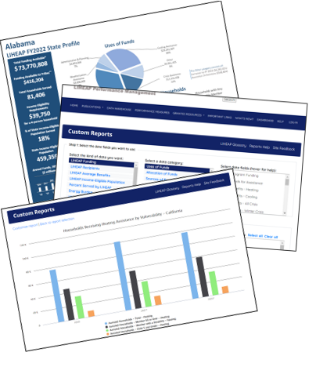
Resources
Assurance 1: USES OF FUNDS
How can we learn more?
Try using the LIHEAP Performance Management Data Warehouse to learn:
What did we do last year with our money?
Grantee Profile gives a one-year snapshot
What have we done over the years with our money?
Standard Reports compares data across years
What have others done with their money?
Standard/Custom Reports compare with other states
Notes:
Data from 2018 plans

Slide 21
Breaking it Down
(Key Takeaways)
Assurance 2: ELIGIBILITY
Section 2605(b)(2) of LIHEAP Act, 42 U.S.C. § 8624(b)(2)
Grant recipients will only make LIHEAP payments to:
Households with a member receiving one or more of the following:
assistance under the State program funded under part A of title IV of the Social Security Act
supplemental security income payments under title XVI of the Social Security Act
food stamps under the Food Stamp Act of 1977
payments under section 415, 521, 541, or 542 of title 38, United States Code, or under section 306 of the Veterans' and Survivors' Pension Improvement Act of 1978
2. Households with an income at or below the greater of 150 percent of the Federal Poverty Guidelines (FPG) or 60 percent of the state’s median income (SMI).
The eligibility limit cannot be set lower than 110% FPG.
Grant recipients can set additional eligibility criteria such as an assets test.
Notes:
Generally speaking, grantees’ policies may be more restrictive than the federal law, but not less so--such as in the case of a grantee including an assets test which the federal law doesn’t require.

Slide 22
Interpretation & Implementation
Assurance 2: ELIGIBILITY
What are the details grant recipients must consider?
How will we determine eligibility?
Will we use categorical eligibility? Will our categorical eligibility requirements include special rules?
Who will be eligible?
Income eligibility guidelines vary across grantees.
There are some grantees who set different income eligibility guidelines for different components of their program.
EXAMPLE: Some states administer LIHEAP Weatherization funds using federal “DOE rules.” This means they can set the income eligibility threshold for weatherization services as high as 200% FPG.
Crisis criteria must be spelled out.
Notes:
There is even variance among grantees in terms of implementation of Cat Eligibility For example, Connecticut requires all household members to be participating in one or more means tested programs in order to be categorically eligible (whereas some other grantees require only one member of the household).
The tribe has flexibility under this section to include as eligible all of those mentioned in the law, or to limit eligible households to a smaller target group.

Slide 23
Bringing it
Back Home
Assurance 2: ELIGIBILITY
How will we interpret and implement Assurance 2?
Eligible v. Assisted Households | Are we satisfied with the percentage of eligible households we are reaching? What would be impact of moving the income eligibility threshold in my state, tribe, or territory?
More Households or Higher Benefits? | Is it more important for our state, tribe, or territory, to serve the highest number of households (even if the benefit amount is low?) Is it more important for our state, territory, or tribe to provide households with a larger benefit (even if we serve fewer households?)
Notes:
For example, if we look at some actual grantee data, we can see the way a lower income eligibility guideline in one state results in a higher percentage of income eligibility households being served.

Slide 24
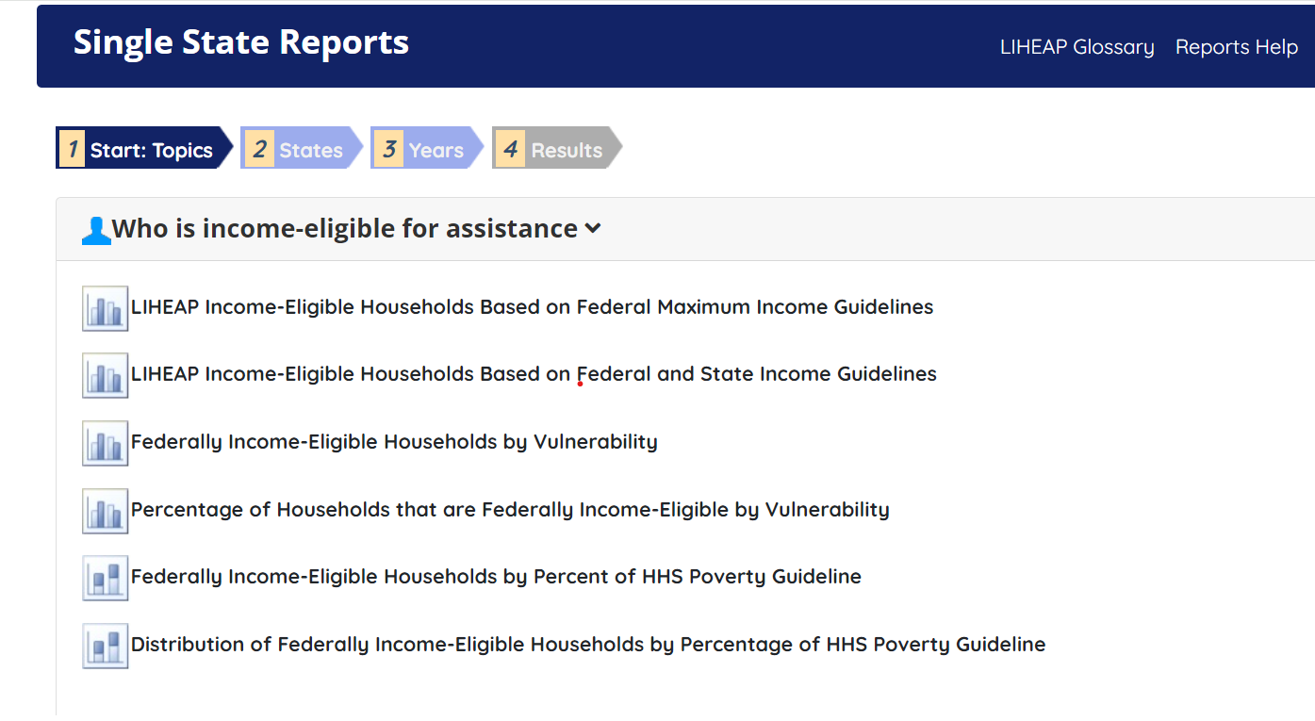
Resources
Assurance 2: ELIGIBILITY
How can we learn more?
The LIHEAP Data Warehouse can tell us:
How income eligible households are distributed (by income group) across each state
The percentage of income eligible households being assisted with LIHEAP in each state
Notes:
Data from 2018 plans

Slide 25
Breaking it Down
(Key Takeaways)
Assurance 3: OUTREACH
Section 2605(b)(3) of LIHEAP Act, 42 U.S.C. § 8624(b)(3)
Grant recipients must conduct outreach activities designed to assure that eligible households know about LIHEAP and other similar energy programs.
Outreach should be especially targeted toward “vulnerable” households, e.g., elderly, young child and/or disabled individuals.
Outreach should also be targeted to those households with high home energy burdens (the lowest income and highest energy costs).

Slide 26
Interpretation & Implementation
Assurance 3: OUTREACH
What are the details grant recipients must consider?
How are we making sure that eligible households know about LIHEAP?
How are we targeting our outreach to vulnerable households?
Traditional examples of LIHEAP Outreach:
Newspaper or radio announcements | Fliers in social service offices, senior centers, community
Social media (e.g., Facebook, Twitter) | Utility company bill inserts
Fliers in food boxes, Meals-on-Wheels, Head Start backpacks | Mailings by the LIHEAP office or other social service programs
Newer examples of LIHEAP Outreach:
Bus and light rail wraps (ads) | Park bench, bus stop advertisements
Gas pump video ads | Mobile outreach trailers/RVs (e.g., libraries, SNAP-ed)
“Speed Dating” style Social Service events | Energy Ed activities w/school-aged children

Slide 27
Bringing it
Back Home
Assurance 3: OUTREACH
How will we interpret and implement Assurance 3?
Targeting | Do we know who is eligible for LIHEAP (e.g. demographics)? Do we know where these eligible households are (e.g., geographically)?
Gaps | Who is applying for LIHEAP services? How does this line up with who is eligible?
Methods | Are we using the right tools to reach who we need to? Are we conducting outreach throughout the year, or just at the beginning of each program?
Goals | Do we have clear outreach goals in our state, tribe, or territory? If local agencies deliver outreach, are they aware of these goals?

Slide 28
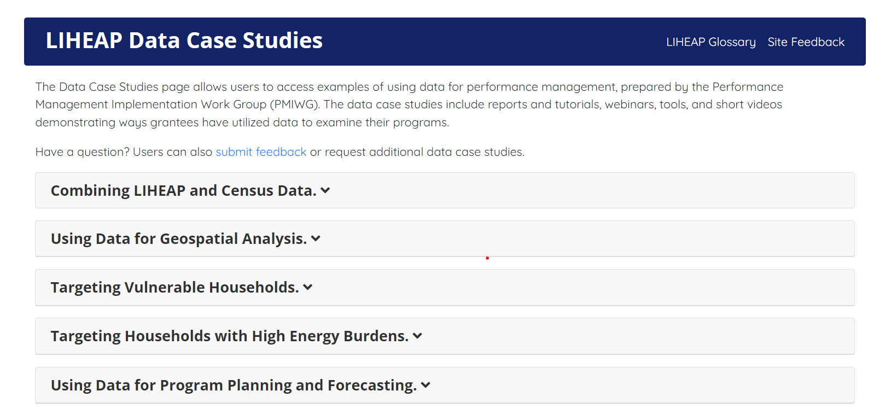
Resources
Assurance 3: OUTREACH
How can we learn more?
LIHEAP Data Case Studies highlight ways that grantees are using data to:
Pinpoint who is and isn’t being served (both by geography and sub-group)
Create outreach goals and monitor outcomes
Notes:
Data from 2018 plans

Slide 29
Breaking it Down
(Key Takeaways)
Assurance 5: BENEFITS
Section 2605(b)(5) of LIHEAP Act, 42 U.S.C. § 8624(b)(5)
Grant recipients will provide benefits in a timely manner.
Grant recipients will assure that the highest level of assistance will be furnished to those households which have the lowest incomes and the highest energy costs or needs in relation to income, taking into account family size.
Grant recipients may not determine benefits differently for households who are categorically eligible and households that are income eligible.
Categorical eligibility means that the household is eligible and that you can move to the benefit determination.
Notes:
Timely manner defined by grantees
LIHEAP determinations involve two parts--(1) are they eligible and (2) if yes, how much benefit will they receive? For the first question, verification of receipt of the qualifying public assistance answers the question, yes, the household is eligible. Then the intake worker needs to confirm usual aspects of benefit matric (HH member #, total income, etc.) to determine the amount of assistance.

Slide 30
Interpretation & Implementation
Assurance 5: BENEFITS
What are the details grant recipients must consider?
How are we assuring that households are served in a timely manner?
For the most part, the statute doesn’t define “timely” (18 and 48-hour crisis timelines are the exception). This is up to each grant recipient Some programs set a target number of days between each client or vendor transaction—for example, a maximum number of days between an application being submitted and intake/processing.
How are we targeting higher benefits to those with higher energy burden (high energy costs/lowest income?)
Most grantees use their benefit matrix to assure that higher benefits are targeted to households with high energy burdens. These must account for income, household size, and energy costs in some way.
How are we making sure that benefits are being determined in the same way for households who are categorically eligible versus households that are income eligible?

Slide 31
Bringing it
Back Home
Assurance 5: BENEFITS
How will we interpret and implement Assurance 5?
Timely Benefits | Do we have the tools in place to monitor the time it takes between a household submitting an application and approval of benefit? Between approval of benefit and payment to vendor? Do we have clear expectations about how much time should (or shouldn’t) elapse between each client/vendor transaction?
Benefit Determination | If our benefit matrix is based on income and energy costs, how are we making sure that we using the same information and processes to determine benefits between categorically eligible households and income eligible households?
Targeting | Does our benefit matrix give higher benefits to those with lower incomes and higher energy costs? How do we know it is working?

Slide 32
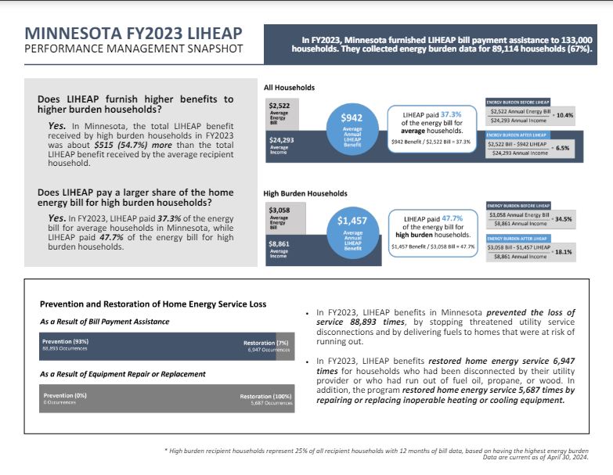
Resources
Assurance 5: BENEFITS
How can we learn more?
The LIHEAP Performance Measures Executive Summary illustrates whether states provided higher benefits to higher burden households during a given year.

Slide 33
Breaking it Down
(Key Takeaways)
Assurance 8: EQUITABLE TREATMENT
Section 2605(b)(8) of LIHEAP Act, 42 U.S.C. § 8624(b)(8)
Grant recipients may not limit eligibility to only those households who are “categorically eligible” for LIHEAP (as discussed in Assurance 2). Grant recipients must offer households the option of income eligibility as well.
Owners and renters must be treated equitably. This includes:
Households that own or are buying their home
Households that rent their home and pay separately for energy costs
Households who rent their home and energy costs are included in the rent
Notes:
“Equitably" does not necessarily mean "equally.“ Equitable means fair, given all of the factors that come into play.

Slide 34
Interpretation & Implementation
Assurance 8: EQUITABLE TREATMENT
What are the details grant recipients must consider?
How do our policies and procedures differ between homeowners and renters?
Most grantees treat homeowners and renters who are responsible for paying their own energy costs equally, using the same eligibility and benefit determination procedures.
“Heat in rent” households have an energy burden that is realized in the form of higher rent payments. In the absence of an energy bill, grantees may use proxy (estimated) energy costs or a percentage of rent to determine a benefit amount.
When heat is included in rent, grantees may pay the household directly or may pay the landlord. Many grantees may require a copy of the lease or a letter signed by the landlord. This may require the landlord to do one or more of the following:
Identify the main heating fuel type used in the home/unit
Estimate the portion of the rent payment used for energy costs
Guarantee that the LIHEAP benefit will be applied to the client’s energy costs
Guarantee that the LIHEAP household will not be evicted for a set period of time
Reduce the household’s next rent payment by the amount of the benefit
Notes:
“Equitably" does not necessarily mean "equally.“ Equitable means fair, given all of the factors that come into play.

Slide 35
Bringing it
Back Home
Assurance 8: EQUITABLE TREATMENT
How will we interpret and implement Assurance 8?
Access | If we automatically enroll households into LIHEAP when they apply for or receive other social service benefits—how are we making sure that households not participating in these programs can just as easily apply?
Household Burden | Are we placing a disproportionately high level of burden on non-categorically eligible households or renters in order to apply for and receive services (asking them for unnecessary documentation that categorically eligible households or homeowners are not required to produce?)
Renter Policies, Procedures | Do we know what percentage of LIHEAP eligible households in our state, tribe, or territory are renters? Have we taken this into consideration when designing our eligibility and benefit determination policies for renters?
Household Protections | If we pay benefits to heat-in-rent households, how are we assuring protections for the household (e.g., landlord applies benefit to rent)?

Slide 36
Breaking it Down
(Key Takeaways)
Assurance 16: SERVICES TO REDUCE NEED
Section 2605(b)(16) of LIHEAP Act, 42 U.S.C. § 8624(b)(16)
Grant recipients may use up to 5 percent of LIHEAP funds, at their option, to provide services that encourage and enable households to reduce their home energy needs and thereby the need for energy assistance.
This includes:
needs assessments
counseling
assistance with energy vendors
Grant recipients must report the impact of such activities on the number of households served, the level of direct benefits provided to those households, and the number of households that remain unserved.

Slide 37
Interpretation & Implementation
Assurance 16: SERVICES TO REDUCE NEED
What are the details grant recipients must consider?
Will we use 5% of LIHEAP funds for the purposes identified in Assurance 16? How?
Grant recipients use Assurance 16 funds for a wide variety of activities:
Needs Assessment and Referral – Reviewing the client’s case record and identifying the most appropriate referrals
Financial Counseling – Working with the client to improve financial management skills and proactively manage energy bills
Energy Education – Furnishing information about how to reduce energy usage and obtain energy efficiency services
Case Management – Working with clients on a customized energy education and/or budget management plan over an extended time period
Vendor Advocacy – Helping the client to communicate effectively with the vendor to maintain service

Slide 38
Bringing it
Back Home
Assurance 16: SERVICES TO REDUCE NEED
How will we interpret and implement Assurance 16?
Fit | How could we use Assurance 16 funding to maximize existing resources or address gaps in service? (e.g., energy advocacy, energy education, payment planning)
Allocation | If we use subgrantees, how will we award these funds to local agencies?
Reporting | How will local agencies (and we as a state, tribe, or territory) reporting outcomes associated with this funding?
Examples | How are other states using these funds? https://liheapch.acf.hhs.gov/delivery/sufficiency.htm

Slide 39
Breaking it Down
(Key Takeaways)
Assurance 4: COORDINATION OF SERVICES
Section 2605(b)(4) of LIHEAP Act, 42 U.S.C. § 8624(b)(4)
Grant recipients must coordinate their LIHEAP program with similar and related programs administered by the Federal Government and State, in particular:
U.S. Dept. of Energy's Weatherization Assistance Program (WAP)
Community Services Block Grant (CSBG) Program
Supplemental Security Insurance (SSI) Program
Social Services Block Grant (SSBG) Program
Temporary Assistance for Needy Families (TANF) Program
Notes:
Coordination means that the LIHEAP staff should work with administrators of other similar programs so that other program officials will be aware of LIHEAP and can make referrals. Coordination often prevents undesired overlap in services between agencies and their programs and ensures that eligible households know about and receive the maximum services and benefits available under all programs listed in this section of the law.

Slide 40
Interpretation & Implementation
Assurance 4: COORDINATION OF SERVICES
What are the details grant recipients must consider?
How do we ensure that LIHEAP households know about services from similar programs?
How do we ensure that other programs are aware of LIHEAP and can make referrals?
How are we preventing duplication or overlap in services between agencies/programs?
Examples of LIHEAP coordination with other services:
Meetings between administrators of various state or tribal low-income programs to discuss issues of mutual concern. | Referrals of clients to other state or tribal low-income programs or from other programs to LIHEAP.
Shared application process (or automated referral) between LIHEAP, WAP, and other fuel assistance programs. | Joint intake procedures alongside other low-income programs (TANF, SNAP, etc).
Combined outreach efforts. | Sharing records when not prohibited by law.

Slide 41
Bringing it
Back Home
Assurance 4: COORDINATION OF SERVICES
How will we interpret and implement Assurance 4?
Shared Clients | Are we working with other programs (at the state and local level) to make it easier for our shared clients to access LIHEAP? Are there hard-to-reach populations that other agencies work with regularly? Are we partnering to conduct outreach?
Avoiding Duplication | What steps are we taking to coordinate services among all LIHEAP providers to avoid duplication of effort and/or benefits?
Subgrantee Coordination | In my state, tribe, or territory--are local agencies expected to fulfill the LIHEAP requirement for coordination of services? If so, are they aware of this expectation? How are we learning of their coordination efforts and/or outcomes?
Notes:
Examples:
Row 1: For example, in some communities, senior center volunteers help elderly patrons complete applications and scan in documentation so that the seniors do not have to make an extra trip into the LIHEAP office for in-person intake. Others are using cultural centers to reach immigrants or mixed citizenship status families who may not be comfortable approaching a conventional office.
Row 2: Tribal Agreements
Row 3: FL multiple agencies serving senior crisis households. OR tribe using state system for LIHEAP.

Slide 42

Resources
Assurance 4: COORDINATION OF SERVICES
How can we learn more?
The Office of Community Services, Division of Energy Assistance Application Streamline and Electronic Verification (ASEV) Workgroup Learnings Report highlights promising practices related to LIHEAP coordination with other programs and/or agencies.
Notes:
Data from 2018 plans

Slide 43
Breaking it Down
(Key Takeaways)
Assurance 6: DESIGNATION OF LOCAL AGENCIES
Section 2605(b)(6) of LIHEAP Act, 42 U.S.C. § 8624(b)(6)
Grant recipients that wish to sub-contract the administration of LIHEAP to other organizations must give “special consideration” to those agencies who received Federal funds under any low-income energy assistance program or weatherization program in the past (prior to the enactment of LIHEAP Act).
Before giving “special consideration,” the grant recipient must determine that the agency involved meets program and fiscal requirements established by the State.

Slide 44
Interpretation & Implementation
Assurance 6: DESIGNATION OF LOCAL AGENCIES
What are the details grant recipients must consider?
How do we define “special consideration?”
"Special consideration" is not defined in the law or the regulations. It is up to the grant recipient to decide how to interpret this phrase. Examples might include awarding priority or preference points, extending deadlines, or expediting portions of the subgrantee contracting process for agencies noted in Assurance 6.
Bringing it
Back Home
How will we interpret and implement Assurance 6?
Contract Processes | Does our current subgrantee contracting/selection process allow us to demonstrate that special consideration was given to agencies noted in Assurance 6?
 | Does our current subgrantee contracting/selection process give too much “special consideration” to particular agencies? Too little?

Slide 45
Breaking it Down
(Key Takeaways)
Assurance 7: VENDOR PAYMENTS
Section 2605(b)(7) of LIHEAP Act, 42 U.S.C. § 8624(b)(7)
Grant recipients who choose to pay home energy suppliers directly must establish procedures to:
Make sure the household knows how much assistance the vendor received as payment for the household's fuel (each household must receive Notice of Action)
Make sure that the vendor reduces the household’s bill by the amount of its LIHEAP benefit and does not overcharge the household.
Make sure that the vendor does not treat LIHEAP households adversely or discriminate against LIHEAP households.
The grant recipient must also ensure that the option to provide vendor payments remains with the state (in consultation with local subgrantees)—and may be contingent on vendors providing special protections, pricing, or services for LIHEAP households.

Slide 46
Interpretation & Implementation
Assurance 7: VENDOR PAYMENTS
What are the details grant recipients must consider?
How am I assuring that LIHEAP benefits are applied to the bill and that households are not treated adversely?
Vendor agreements are the most common way to protect the client—assuring that the benefit is applied correctly, and that the client is not treated adversely as a result of receiving LIHEAP. Additionally, agreements lay out how the vendor will refund monies to the appropriate agency.
How am I using vendor payments to leverage additional protections for clients?
Some grant recipients have used vendor agreements to negotiate additional protections for clients. For example, in some areas, when a utility accepts a LIHEAP benefit, they agree to maintain energy service to the household for a minimum time period (e.g., 30-60 days). In other cases, grant recipients have used vendor payments to leverage discounted fuel pricing for LIHEAP households.

Slide 47
Bringing it
Back Home
Assurance 7: VENDOR PAYMENTS
How will we interpret and implement Assurance 7?
Vendor Agreements | If there is not a vendor agreement in place, how are we assuring the LIHEAP protections noted under this assurance? Are there other LIHEAP grantees with whom we could partner to develop and/or negotiate vendor agreements?
Vendor Monitoring | How are we making sure that vendors are applying benefits correctly and not treating LIHEAP clients adversely? Do households have a designated number or person to contact if their benefit is not applied correctly or in a timely manner? If they feel they are being treated adversely by the vendor?
Additional Protections | How could we collaborate with vendors to negotiate more protections or services for LIHEAP households (e.g., payment plans, discounted rates, arrearage reduction, waived deposit or late fees, waived reconnection fees)?

Slide 48
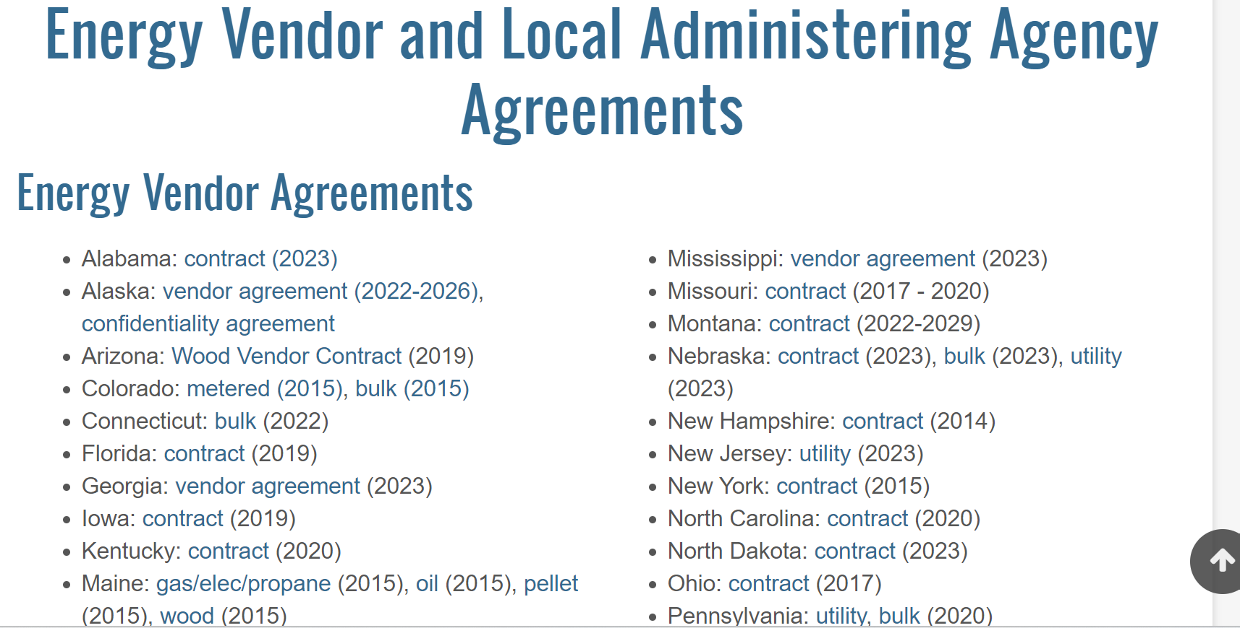
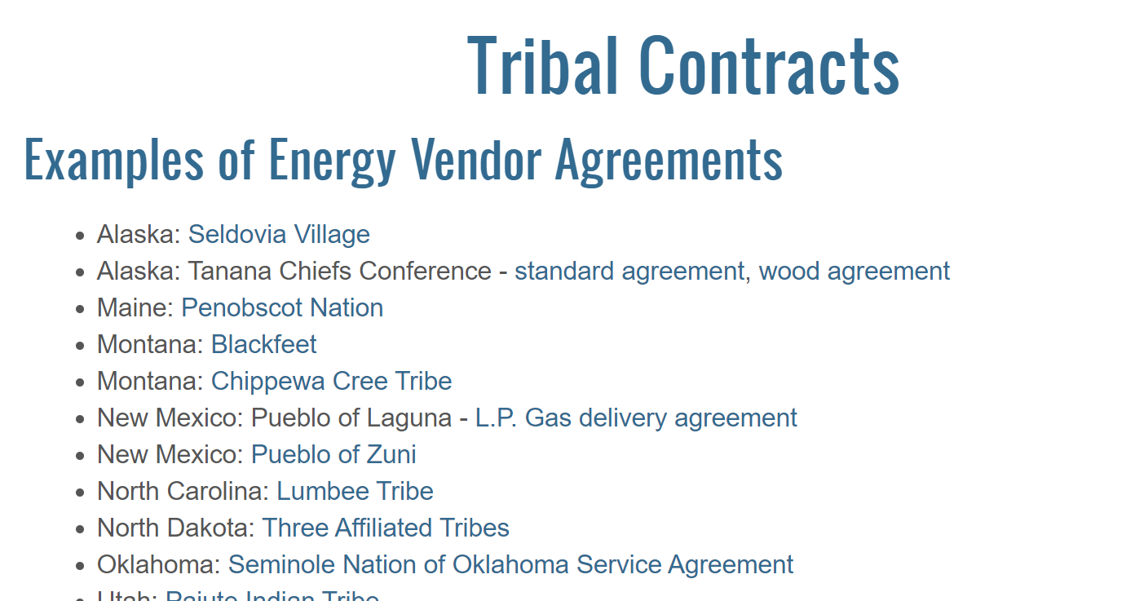
Resources
Assurance 7: VENDOR PAYMENTS
How can we learn more?
The LIHEAP Clearinghouse provides examples of vendor agreements developed by state and tribal grant recipients.
Reviewing these examples might provide ideas for LIHEAP administrators who are currently developing or updating their own vendor contracts.

Slide 49
Breaking it Down
(Key Takeaways)
Assurance 9: ADMINISTRATIVE COSTS
Section 2605(b)(9) of LIHEAP Act, 42 U.S.C. § 8624(b)(9)
States may not spend more than 10% of their annual allocation on program administration.
Tribes may spend 20% of the first $20,000 of their grant on administrative funds and 10% of any funds above $20,000. A tribe that receives $100,000 in LIHEAP may spend $12,000 on administrative costs (20% * $20,000) + (10% * $80,000)
The administrative funds cap extends to all federal dollars. grant recipients may not use other federal funds for administrative costs if the total spent will exceed the 10% administrative cap. They may use state, tribe, or non-governmental funds for administrative costs above the cap.

Slide 50
Interpretation & Implementation
Assurance 9: ADMINISTRATIVE COSTS
What are the details grant recipients must consider?
How do we define administrative costs?
The LIHEAP statute does not define administrative costs. grant recipients must develop their own definitions of have their own definition of administrative and program costs.
Common administrative costs include: salaries for administrative staff, budgeting, monitoring, personnel, and IT maintenance.
Common program costs include: providing benefits, salaries for program staff (for direct client services), case management, outreach, IT development costs.
Grant recipients must have clear documentation of their allowable administrative and program costs definitions.

Slide 51
Bringing it
Back Home
Assurance 9: ADMINISTRATIVE COSTS
How will we interpret and implement Assurance 9?
Documentation | Do we know where to find a clear explanation of allowable program and administrative costs in my state, tribe, or territory? When was the last time these cost definitions were reviewed? If we use subgrantees to administer LIHEAP, do they know where to find clear allowable cost definitions?
Flexibility | Are there areas where our program has skimped because we didn’t realize our flexibility in defining program versus administrative costs? Have we reviewed other grantee cost definitions to see how they categorize particular expenses that we are unclear about?

Slide 52
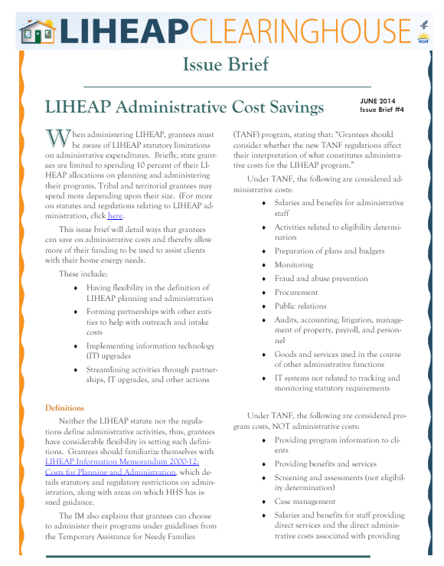
Resources
Assurance 9: ADMINISTRATIVE COSTS
How can we learn more?
LIHEAP Information Memorandum 2000-12: Costs for Planning and Administration** details statutory and regulatory restrictions on administration and outlines related HHS guidance.
The LIHEAP Clearinghouse published an Issue Brief in 2014 titled LIHEAP Administrative Cost Savings, which breaks down IM 2000-12 and provides example cost definitions from LIHEAP grant recipients.

Slide 53
Breaking it Down
(Key Takeaways)
Assurance 10: MONITORING AND AUDITS
Section 2605(b)(10) of LIHEAP Act, 42 U.S.C. § 8624(b)(10)
The grantee will establish procedures necessary to assure to the proper disbursal of and accounting for Federal LIHEAP funds. More specifically:
Fiscal control and fund accounting
Monitoring of the program
Compliance with the Single Audit Act (31 USC Ch. 75)

Slide 54
Interpretation & Implementation
Assurance 10: MONITORING AND AUDITS
What are the details grant recipients must consider?
How are we assuring the proper disbursal and accounting for Federal LIHEAP funds?
Grant recipients must obligate and expend funds in accordance with their own laws and procedures. Furthermore, grant recipients’ fund accounting procedures should allow ready reporting and tracing of funds to proper expenditures.
Monitoring of the program should include procedures to check eligibility determination and calculating benefit payments.
On-site subgrantee/local agency monitoring visits generally include reviewing both a random and/or targeted sample of files.
Most grantees conduct program monitoring of subgrantees at least once every three years (many monitor subgrantees annually). In some cases, desk reviews are used to both supplement and prioritize on-site visits.
Financial monitoring should be conducted to prevent waste, fraud and abuse.
Most grantees conduct subgrantee fiscal monitoring on a yearly basis. Additionally, many grantees have a process for systematically reviewing subgrantees’ single audit reports each year.

Slide 55
Bringing it
Back Home
Assurance 10: MONITORING AND AUDITS
How will we interpret and implement Assurance 10?
Desk Reviews, Risk Assessments | Are we conducting risk assessments or desk reviews to prioritize or supplement our local agency/subgrantee monitoring? If we have subgrantees, is there a systematic process for receiving, reviewing, and responding to their single audit reports in we office?
Tools | What processes and tools are in place to conduct local agency/subgrantee site visits? When was the last time these tools were updated?
Collaboration | How are the fiscal and program monitoring staff working together in my state/tribe/territory to identify risk, share concerns, or flag training and technical assistance needs?

Slide 56
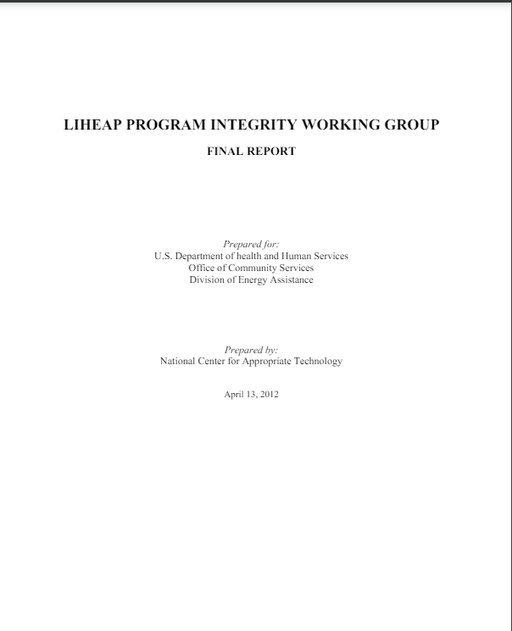
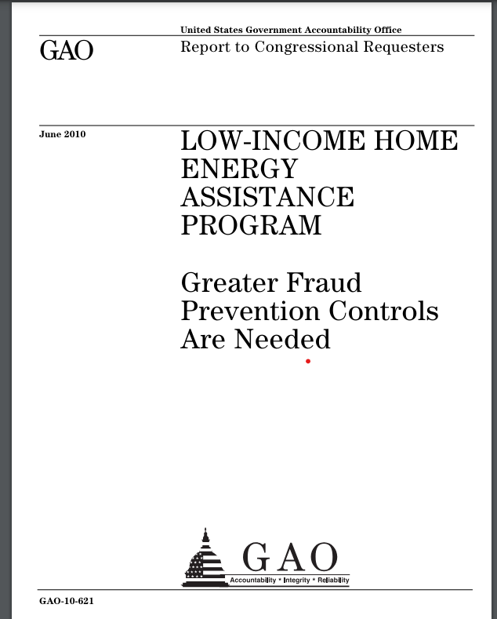
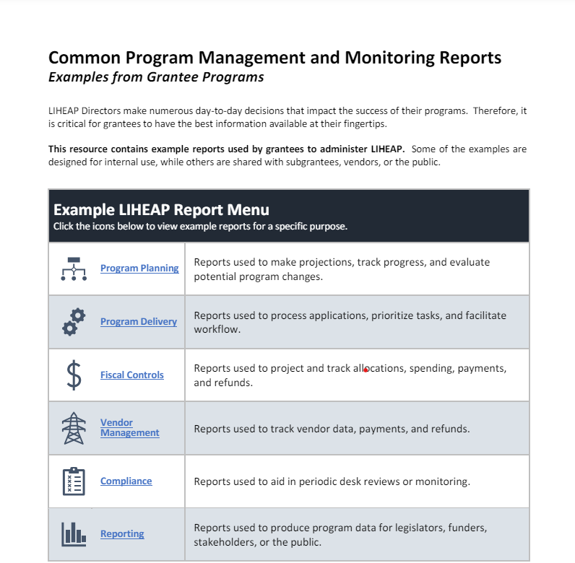
Resources
Assurance 10: MONITORING AND AUDITS
How can we learn more?
June 2010 Government Accountability Office (GAO) report--Low Income Home Energy Assistance Program: Greater Fraud Prevention Controls Are Needed
In response to the 2010 GAO report, the LIHEAP Program Integrity Working Group developed their own report which includes noteworthy program integrity practices and examples.
Members of the LIHEAP Performance Management Implementation Work compiled a list of example system reports they regularly use to manage and monitor LIHEAP programs.

Slide 57
Breaking it Down
(Key Takeaways)
Assurance 11: COOPERATION W/ INVESTIGATIONS
Section 2605(b)(11) of LIHEAP Act, 42 U.S.C. § 8624(b)(11)
Grant recipients must permit and cooperate with Federal investigations undertaken in accordance with Section 2608 of LIHEAP Act (42 U.S. Code § 8624).
This includes:
Follow-up on “complaints of a substantial or serious nature that a State has failed to use funds in accordance with the LIHEAP Law or the assurances provided by the State…”
Compliance Reviews

Slide 58
Interpretation & Implementation
Assurance 11: COOPERATION W/INVESTIGATIONS
What are the details grant recipients must consider?
How will we quickly cooperate with Federal LIHEAP Investigation requests?
Grant recipients must be prepared to make requested files or other paperwork available to federal officials who are conducting an investigation for the LIHEAP program. This includes documentation that may be housed at local agencies. Many grant recipients include language that mirrors Assurance 11 into subgrantee agreements.
Bringing it
Back Home
How will we interpret and implement Assurance 11?
Local Agency Agreements, Contracts | If we use local agencies to deliver LIHEAP, does the agreement/contract include language regarding timely cooperation with state and federal LIHEAP investigations? Do our partner agreements and/or policy manual set clear archiving rules to assure that documentation is readily available?

Slide 59
Breaking it Down
(Key Takeaways)
Assurance 12: PUBLIC PARTICIPATION
Section 2605(b)(12) of LIHEAP Act, 42 U.S.C. § 8624(b)(12)
Grant recipients must provide for timely and meaningful public participation in the development of the LIHEAP model plan.

Slide 60
Interpretation & Implementation
Assurance 13: PUBLIC PARTICIPATION
What are the details grant recipients must consider?
How am I assuring that members of the public, especially those eligible for LIHEAP, have input in how we will spend LIHEAP funds?
Many grantees begin working on their model plan in the late winter or early spring. This allows them to make the Model Plan available for the public with plenty of time for review and comment.
Some grantees engage local agencies and/or major stakeholders in helping to consider new policy and develop revisions to the previous year’s Model Plan.
Other ways that grantees assure “timely and meaningful” public participation:
Presenting the plan to existing stakeholder groups (e.g., advisory committees)
Holding “listening sessions” or hearings in geographically accessible locations
Allowing alternative forms of feedback (e.g., email, public webinars, online forums)
Community meetings in under-served locations
Asking advocates or “gatekeepers” to sponsor meetings in hard-to-reach areas

Slide 61
Bringing it
Back Home
Assurance 12: PUBLIC PARTICIPATION
How will we interpret and implement Assurance 12?
Engaging | Who normally provides feedback regarding our LIHEAP Model Plan? Who isn’t providing feedback that should be?
Strategy | What is our plan for reaching people that normally wouldn’t engage in decision making? What is our plan for getting feedback from those hard-to-reach households (including LIHEAP eligible HH who aren’t applying?)
Coordination | How can we coordinate with other programs or agencies to facilitate timely and meaningful participation in development of our plan?
Process | Do we have a process for timely and meaningful participation when major/substantial updates are made to the Model Plan mid-year?

Slide 62
Breaking it Down
(Key Takeaways)
Assurance 13: FAIR HEARINGS
Section 2605(b)(13) of LIHEAP Act, 42 U.S.C. § 8624(b)(13)
Grant recipients must provide an opportunity for a fair administrative hearing to individuals whose application for LIHEAP assistance
are denied, or
are not acted upon with reasonable promptness

Slide 63
Interpretation & Implementation
Assurance 13: FAIR HEARINGS
What are the details grant recipients must consider?
How am I making sure that households know about their right to a fair hearing?
Most grantees require all local offices (including subgrantees) to assure all clients are informed of their rights to a fair hearing. This includes:
Signs everywhere (lobby, intake desk, bathrooms, bulletin boards)
Flier or notice in the application packet
Text included in online application materials
Language on the client application (normally included near the signature line)
Statement made during in-person intake
Language in the client notice of action
Language in the denial letter
Wherever possible, notification of fair-hearing rights should include clear instructions for households if they wish to initiate the fair hearing process.

Slide 64
Bringing it
Back Home
Assurance 13: FAIR HEARINGS
How will we interpret and implement Assurance 13?
Process | Are we clear about what steps would be taken in our state, tribe, or territory if someone requests a fair hearing? Do these steps differ between applications that were denied v. applications not acted upon in a timely manner? Do I know what part I must play (as a LIHEAP director) in the fair hearing process? Appeals?
Documentation | Do we require local agencies/subgrantees to maintain specific records via fair hearings? Are they required to submit paperwork or otherwise inform us when a fair hearing is initiated (including outcomes)?
Monitoring | While monitoring local offices or subgrantee agencies, do we physically look around the office (waiting area, intake area, etc) for Fair Hearing Notices? Do we check client documentation to be sure that the Fair Hearing Notice is clear and conspicuous? Do we ask to see records of fair hearing requests and outcomes?

Slide 65
Breaking it Down
(Key Takeaways)
Assurance 14: REPORTING
Section 2605(b)(14) of LIHEAP Act, 42 U.S.C. § 8624(b)(14)
Cooperate with the Secretary with respect to data collecting and reporting under section 2610 of the LIHEAP Act (42 U.S. Code § 8624).
This includes:
information concerning home energy consumption
the amount, cost and type of fuels used for households eligible for LIHEAP assistance
the type of fuel used by various income groups;
the number and income levels of households assisted with LIHEAP
the number of households which received LIHEAP and include one or more individuals who are 60 years or older or disabled or include young children; and
the impact of each State's program on recipient and eligible households

Slide 66
Interpretation & Implementation
Assurance 14: REPORTING
What are the details grant recipients must consider?
How will we cooperate with Federal LIHEAP Reporting Requirements in a timely manner?
In order to comply with federal reporting requirements, grant recipients must have a fiscal accounting system, as well as a means to track data for households assisted with LIHEAP. For those grantees that use subgrantees, it will be necessary to utilize a central database or have a method in place to collect household level data from all local agencies for compilation at the state, territory, or tribal level.
Bringing it
Back Home
How will we interpret and implement Assurance 14?
Collecting and Reporting Data | What does our state, tribe, or territory need to improve our data collection and reporting processes?
 | If we do not have adequate data (IT) systems, are there ways we can leverage other existing LIHEAP systems (in part or in whole) for use in our tribe, state, or territory?

Slide 67
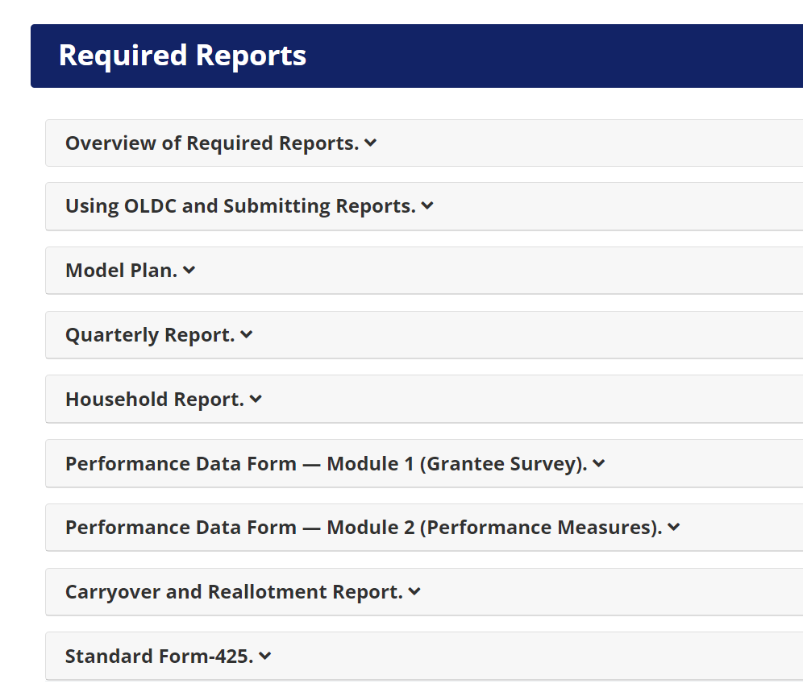
Resources
Assurance 14: REPORTING
How can we learn more?
The Required Reports page on the LIHEAP Performance Management website includes:
A reporting timeline
Instructions and relevant training materials for each report
HHS communication (e.g., Information Memoranda and Action Transmittals) related to each report
Tools/resources to help grantees collect and report accurate data related to specific reporting requirements

Slide 68
Breaking it Down
(Key Takeaways)
Assurance 15: OUTREACH AND INTAKE
Section 2605(b)(15) of LIHEAP Act, 42 U.S.C. § 8624(b)(15)
This assurance requires Grant Recipients to provide LIHEAP outreach and intake services through agencies beyond just the welfare agencies that administer the Temporary Assistance for Needy Families (TANF) Program. This can include, but is not limited to:
community action agencies
area agencies on aging
not-for-profit neighborhood-based organizations
This assurance is applicable only to States, and to territories whose annual regular LIHEAP allotments exceed $200,000. Neither territories with annual allotments of $200,000 or less nor Indian tribes/tribal organizations are subject to Assurance 15.

Slide 69
Interpretation & Implementation
Assurance 15: OUTREACH AND INTAKE
What are the details grant recipients must consider?
How am I assuring adequate outreach and crisis assistance through locally accessible agencies?
Generally, grantees assure adequate outreach and crisis in their state, tribe, or territory by using subgrantees (e.g., local organizations, Community Action Agencies) to conduct some or all LIHEAP outreach and intake.
Bringing it
Back Home
Assurance 15: OUTREACH AND INTAKE
How will we interpret and implement Assurance 15?
Access | Are there underserved areas of our state or territory that could benefit from the addition of a local or satellite office?
 | Do we ensure that households that might feel stigmatized by going to a TANF intake agency to apply for LIHEAP have other intake options?

Slide 70

Resources and Contacts

Slide 71
Important Resources
LIHEAP Clearinghouse: The LIHEAP Clearinghouse contains LIHEAP State Plans, Manuals, contracts, and other administrative documents. Additionally, the Clearinghouse provides an extensive list of publications related to all areas covered in this training session. grant recipients are encouraged to call Clearinghouse staff if they need assistance finding resources.
OCS Website: The OCS website provides resources for LIHEAP grantees including information memoranda, Dear Colleague notices, and training materials.
LIHEAP Virtual Library: The LIHEAP Virtual Library was designed by grantees to help their peers walk through all aspects of LIHEAP program administration.
LIHEAP Performance Management Website: The LIHEAP Performance Management website includes a data warehouse with basic and advanced reporting tools. Additionally, the website contains a wealth of grantee resources related to LIHEAP data, required reporting, and Performance Management.
The Grant Recipient Resource Guide: Provides an overview of various LIHEAP elements. Much of the material in this presentation came from the grant recipient Resource Guide.

Slide 72
CONTACT INFORMATION:
Melissa Torgerson
Verve Associates LLC
melissa@verveassociates.net
503-706-2647

