Slide 1
Insights from the Poverty Tracker:
Energy Insecurity in New York City

Slide 2

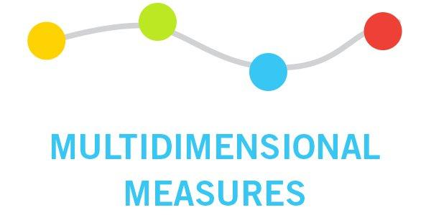

Poverty Tracker Background: Original goals of the study
Get a better measure of poverty in New York City.
Provide a more comprehensive understanding of disadvantage beyond poverty.
Understand the dynamics of poverty and disadvantage over time and how these experiences respond to policy interventions and other life events and circumstances.

Slide 3
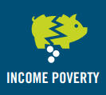


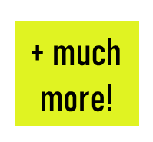
Poverty Tracker Background: Study design
Interview more than 3,000 households up to 3 times a year for up to 7 years.
Longitudinal study that checks in with the same New Yorkers from each of the study’s cohorts multiple times a year for several years, collecting information on key economic indicators at multiple points over time.
How New Yorkers are faring each year; the changes and persistence of these experiences over time; and the policies, programs, life events and circumstances associated with reducing and exacerbating poverty and economic insecurity.

Slide 4
Poverty Tracker Background: Core Measures
Three Core Measures of Disadvantage
All Collected on the Annual Poverty Tracker Surveys

Slide 5
Poverty Tracker Background: Core Measures
The Official Poverty Measure (OPM) and the Supplemental Poverty Measure (SPM)
Poverty has been measured under the Official Poverty Measure (OPM) since the 1960s.
The OPM measures poverty by comparing pre-tax cash income with a national threshold.
In contrast to the OPM, the SPM (among other changes):
Accounts for the value of taxes and non-cash transfers in family resources
Accounts for differences in costs of living by geography

Slide 6
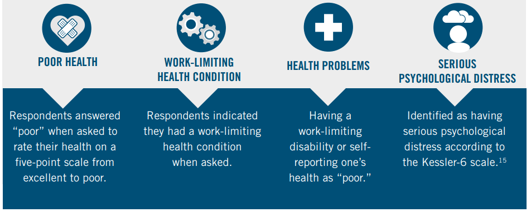
Poverty Tracker Background: Core Measures

Slide 7
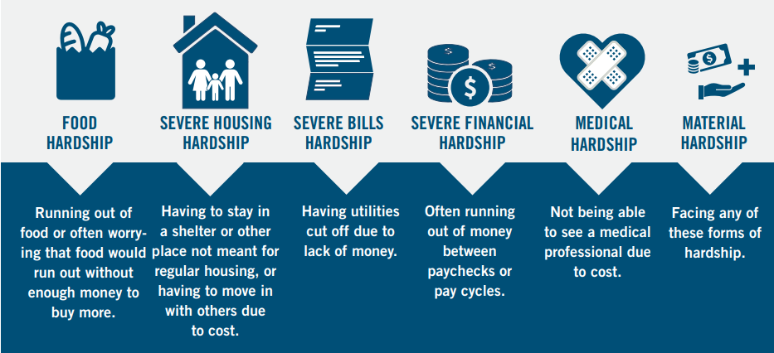
Poverty Tracker Background: Core Measures

Slide 8
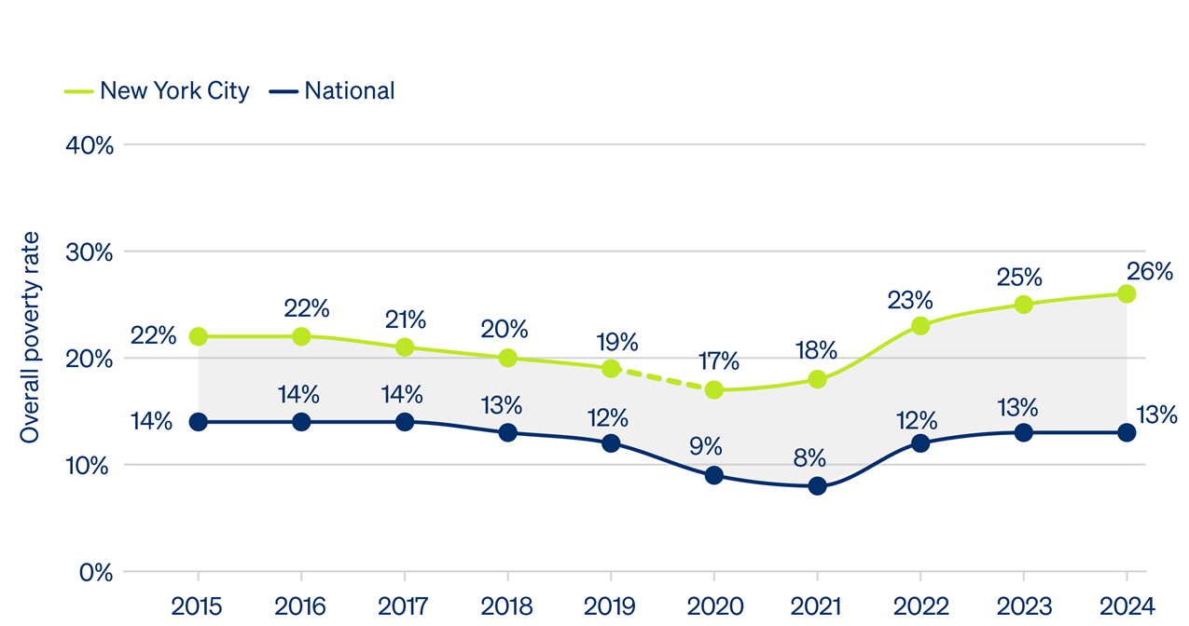
Current State of Poverty
Overall poverty rates in NYC rose again in 2024, reaching the highest level since we began Poverty Tracker.
Notes:
•More than 2.2 million new Yorkers lived in poverty, highest level on record since we started the poverty tracker 12 years ago
•
•Asian and Latino New Yorkers were more than twice as likely to live in poverty in 2024 than white New Yorkers (30% and 33% vs. 14%), and rates were similarly elevated among Black New Yorkers (27%). There is suggestive evidence that these gaps may be widening.

Slide 9
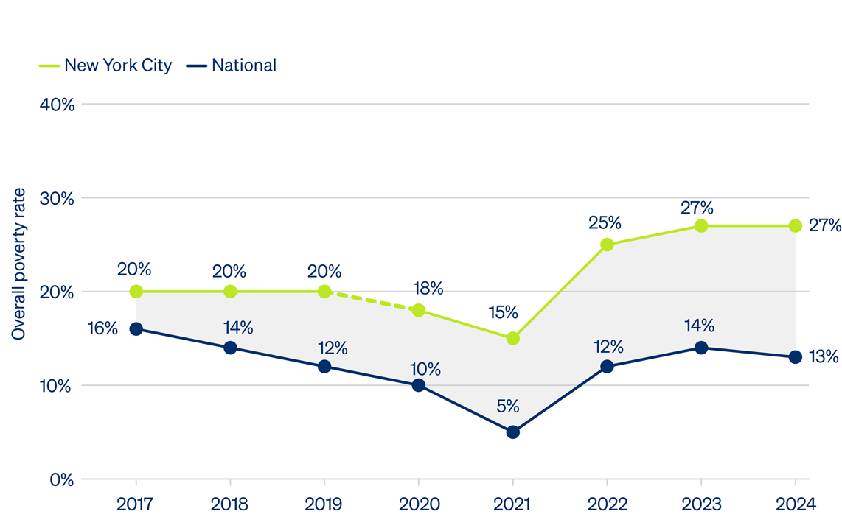
Current State of Poverty
Child poverty in NYC held constant, but is now more than 2x the national rate.

Slide 10
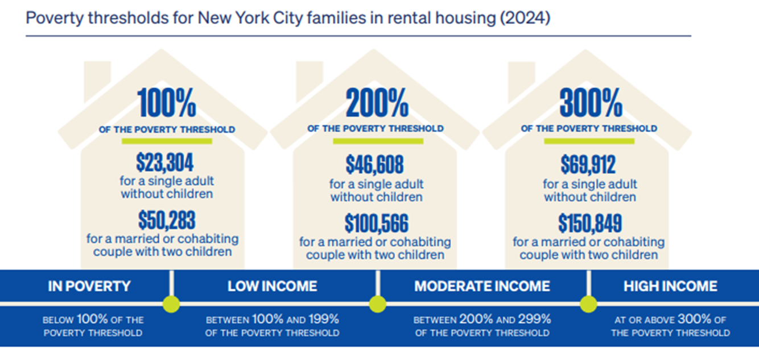
2024 Poverty Thresholds for Families in Rental Housing
SPM: In poverty = (Post-tax cash income + in-kind benefits – nondiscretionary expenses) < Poverty threshold

Slide 11
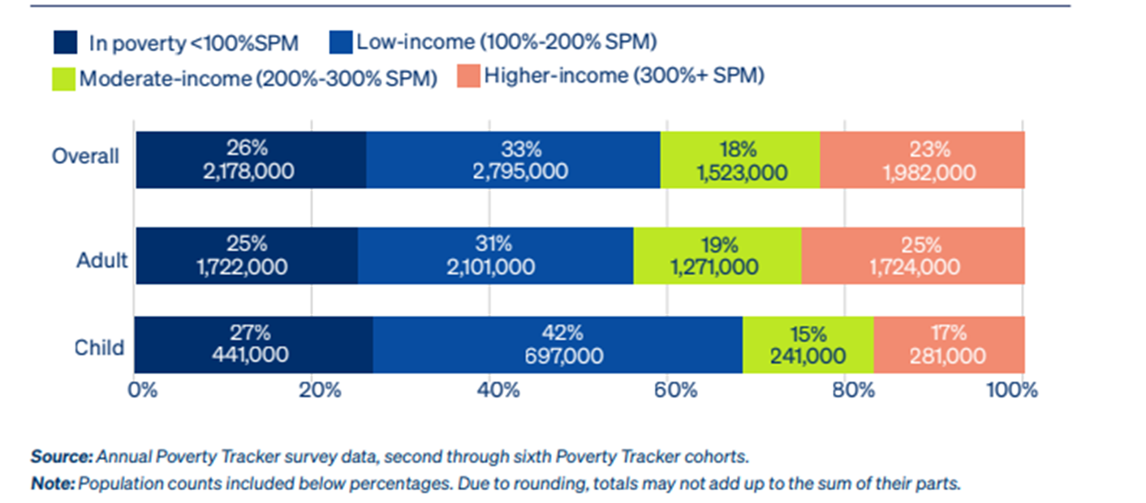
Nearly 3 in 5 New Yorkers (5 million) lived below 200% of the poverty line.

Slide 12
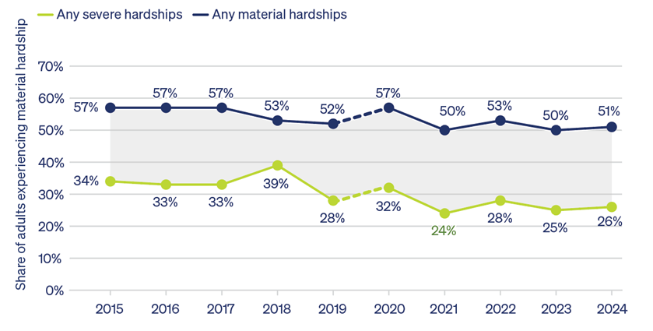
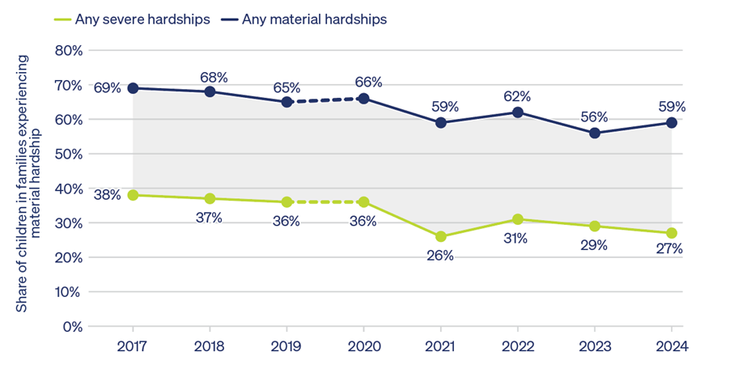
Hardship & Disadvantage
Adult Hardship Rate in NYC (2015-2024)
Child Hardship Rate in NYC (2017-2024)
More than half of adults and 2 in 3 families with children experienced at least one form of material hardship in 2024.

Slide 13
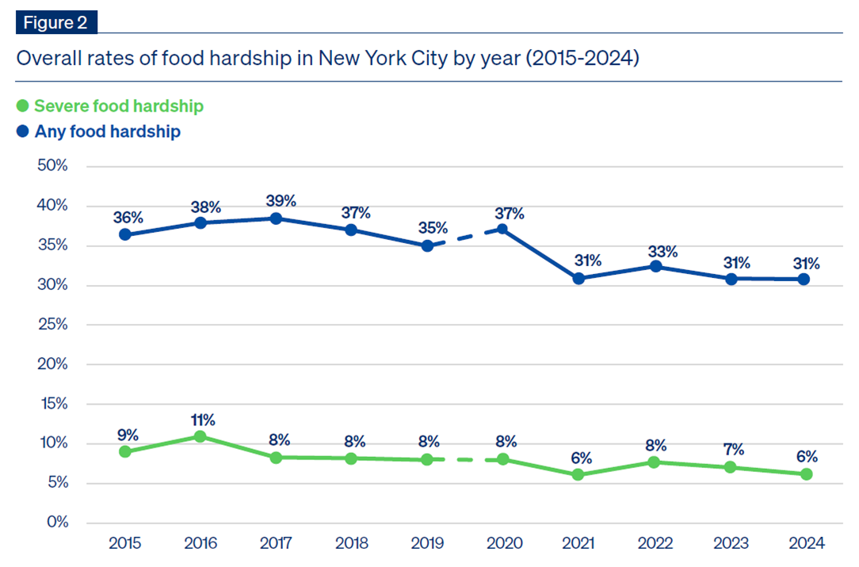
In 2024, 6% of New Yorkers experienced severe food hardship. This translates to nearly 550,000 people often running out of food or worrying that food will run out before having money to buy more. About 1 in 3 New Yorkers reported at least some form of food hardship, or 2.6 million people.

Slide 14
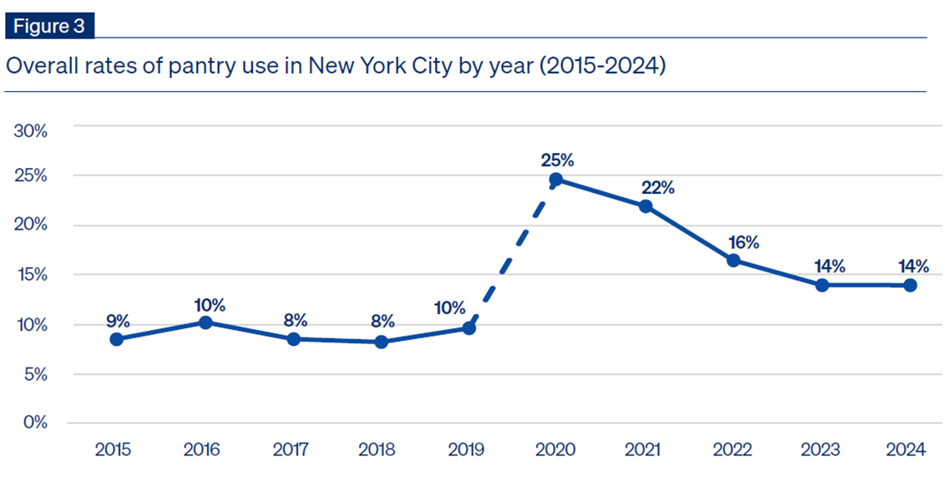
Food pantry use spiked during the pandemic and has remained elevated in the years since.
Notes:
•14% of New Yorkers reported using a food pantry in 2024
•This translates to nearly 1.2 million food pantry users across the city

Slide 15
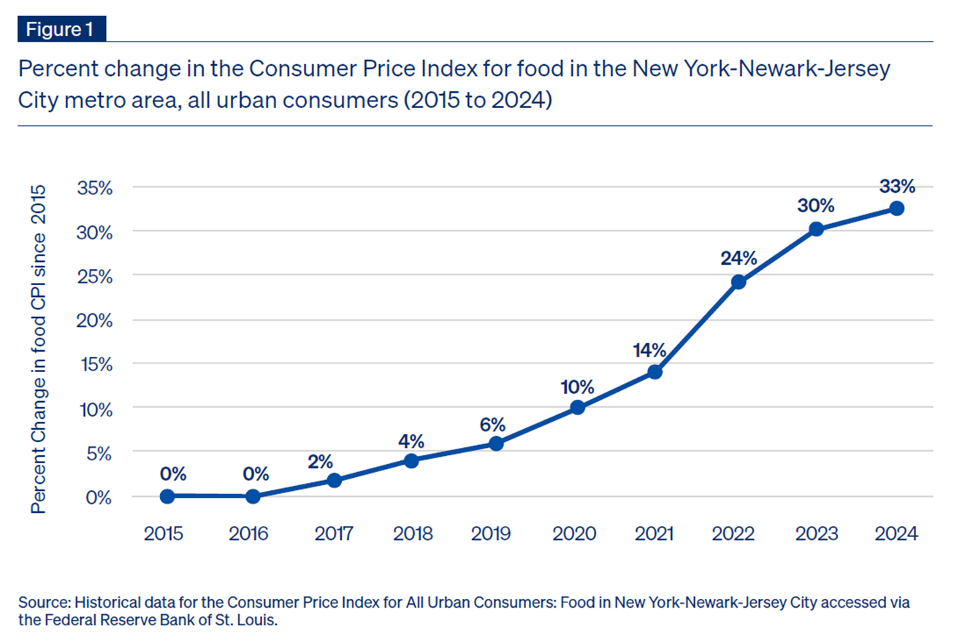
Food prices have risen by 33% in the NYC metro area over the past 10 years.
Notes:
•This translates to nearly 1.2 million food pantry users across the city

Slide 16
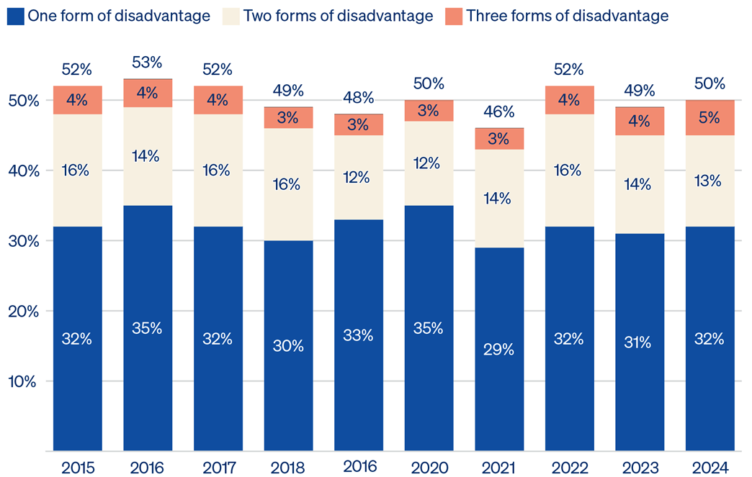
Half of New Yorkers had at least one form of disadvantage in 2024.

Slide 17
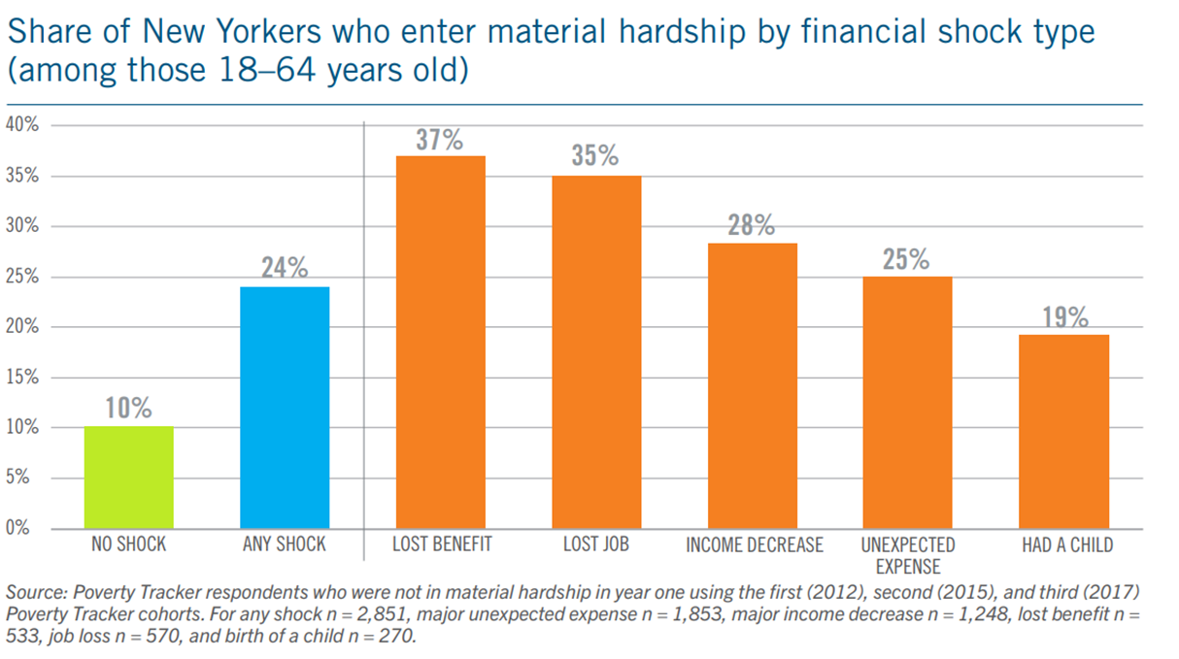
Economic shocks are relatively common and can push people into poverty or hardship.

Slide 18
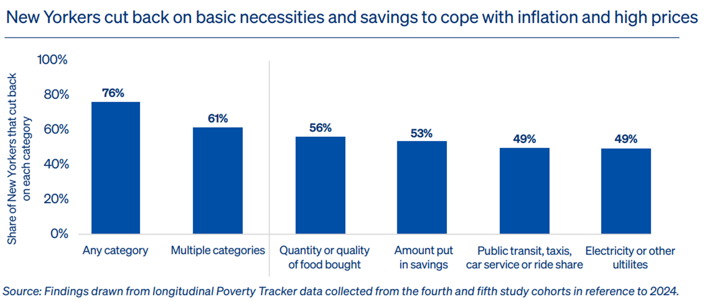
Inflation has created greater instability for New Yorkers

Slide 19
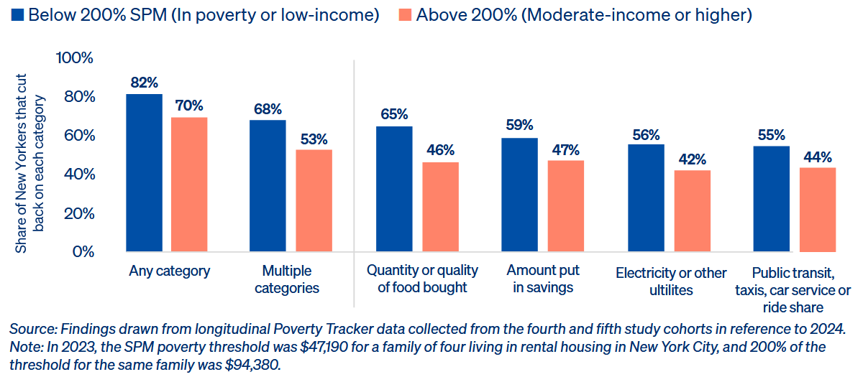
New Yorkers in poverty or with low incomes were more likely to cut back on basic necessities and savings to cope with inflation and high prices.

Slide 20
How is energy insecurity measured in the Poverty Tracker?
Couldn’t afford a utility payment and fell behind:
In the past 12 months, did you not pay the full amount of your phone, gas, oil, or electricity bill because there wasn’t enough money?
Utilities shutoffs after not being able to make full payments:
In the past 12 months, was your phone, gas, or electricity service ever cut off because there wasn’t enough money to pay the bills?

Slide 21
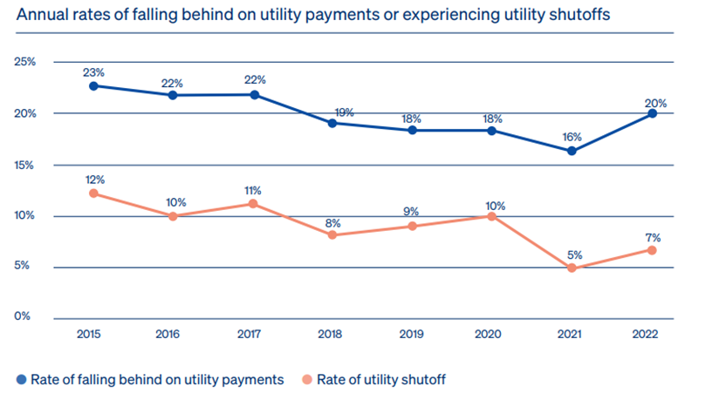
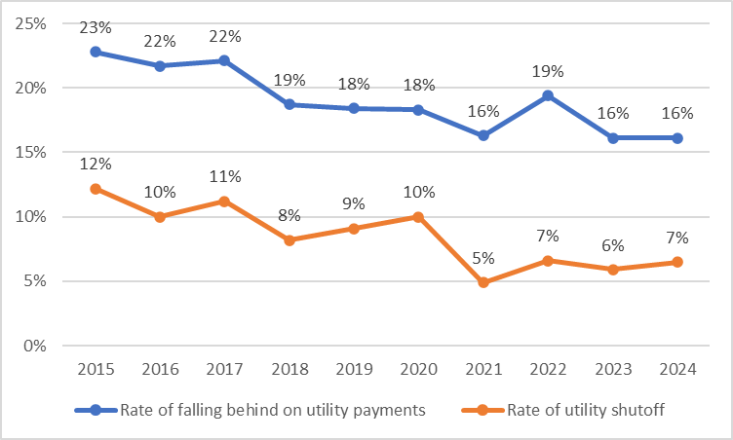
Energy insecurity among New Yorkers

Slide 22
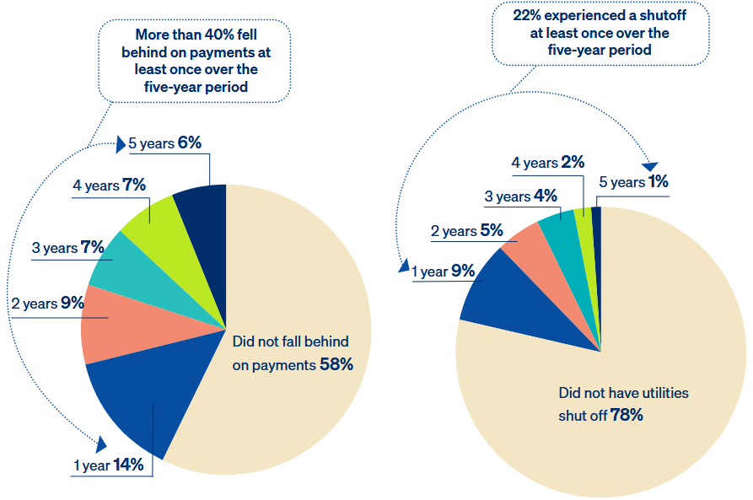
Persistence of energy insecurity among New Yorkers

Slide 23
Overlap between energy insecurity and other material hardships
The “Trifecta of Insecurity”: food, housing, and energy insecurity
More than 2-in-3 New Yorkers (68%) who fell behind on utility payments were not able to pay the full amount of rent or mortgage at least once in the five-year period examined.
More than a third (37%) of New Yorkers that experienced a shutoff in the five-year period examined reported often running out of food and not having money to get more.
Energy insecurity is frequently experienced concurrently with food, housing, financial, and medical hardship.

Slide 24
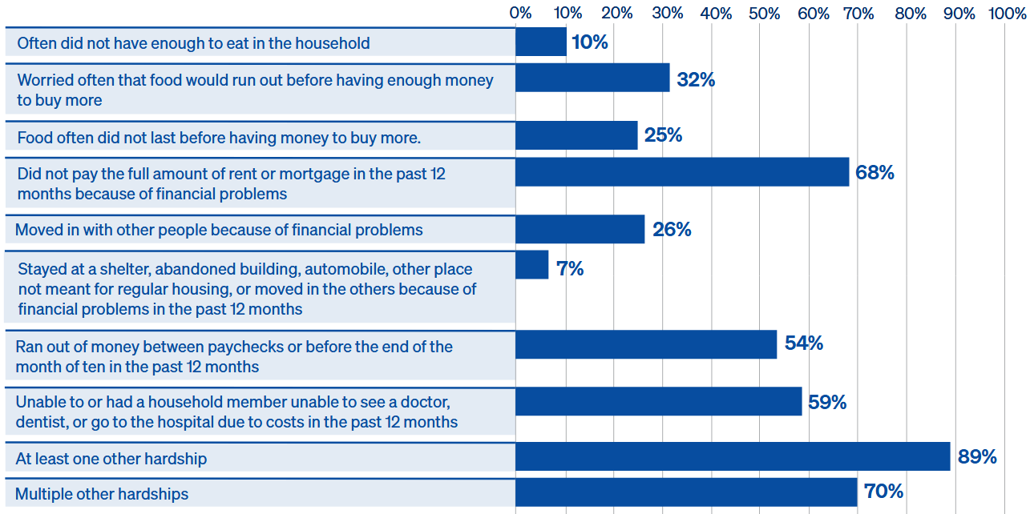
Prevalence of other hardships among New Yorkers that fell behind on utility payments at least once in a five-year period
Notes:
70% of New Yorkers who could not afford a utility payment at least once in a five-year period also
faced multiple other forms of material hardship in the same period, including not being able to
afford rent, food, or medical care.

Slide 25
Prevalence of other hardships among New Yorkers that fell behind on utility payments at least once in a five-year period

Slide 26
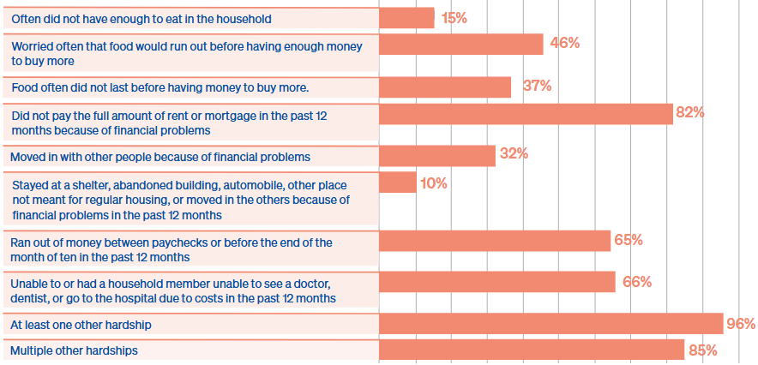
Prevalence of other hardships among New Yorkers that had a utility shutoff at least once in a five-year period
Notes:
The same is true for 85% of New Yorkers who had their utilities shut off.

Slide 27
Prevalence of other hardships among New Yorkers that had a utility shutoff at least once in a five-year period

Slide 28
Energy insecurity among different sociodemographic groups
While energy insecurity was prevalent among many New Yorkers, some groups were disproportionately burdened. Across the five years examined:
New Yorkers in poverty were three times as likely to have fallen behind on utility payments at least once compared to New Yorkers above 300% of the poverty line (62% vs. 18%) and eight times as likely to have had their utilities shut off (43% vs. 5%).
Renters were more than four times as likely to have fallen behind on utility payments than homeowners without a mortgage (52% vs 12%), and close to a third of renters faced a utility shutoff (30%), while shut-offs were hardly ever experienced by homeowners without a mortgage (2%).
Across all groups disproportionately experiencing utility shutoffs or falling behind on utility payments in this five-year period, the majority faced these hardships in two or more years.

Slide 29
Potential policy remedies
A policy response to energy insecurity
Expand access to programs that directly reduce electricity costs such as LIHEAP and NYS’s Energy Affordability Program
Expanding disconnection protections and eliminating fees and deposit requirements
Improving building performance and energy efficiency to reduce energy use and costs
Bolstering New Yorkers’ incomes

Slide 30
Thank you! Christopher Wimer Director, Center on Poverty and Social Policy Columbia University School of Social Work Email: christopher.wimer@columbia.edu Website: povertycenter.columbia.edu

